Slide 1
Data Analysis and Visualization in R
Jenn Schilling
June 5, 2022
Notes:
Your notes here

Slide 2
Introduction to Workshop
Notes:
Hello! Welcome to the AIR Forum Pre-Conference and to the Data Analysis and Visualization in R workshop. We are in Phoenix, Arizona on O’odham and Hohokam land. I am so glad you’re here! Let’s get things started with some introductions.

Slide 3

Jenn Schilling
she/her/hers
Senior Research Analyst, University Analytics & Institutional Research, University of Arizona
Adjunct Faculty, College for Creative Studies
Notes:
I’m Jenn Schilling, my pronouns are she/her/hers, and it is an honor to be with you today. I am a senior research analyst at the University of Arizona, and an adjunct faculty member at the College for Creative Studies where I teach graduate classes on data visualization. I have been using R for the past 10 years for data analysis, modeling, and visualization. In one of my classes at the College for Creative Studies, I teach data visualization in R. I love data visualization and R, so I am super excited to be speaking to you about these topics today. I have experience as a middle school teacher, data visualization consultant, operations research engineer in the supply chain, statistician in advertising and market research, and analyst in higher education.
Thank you for being here. I hope you will find this workshop beneficial.

Slide 4
Schedule
Time | Activity
12:30 - 1:15 | Introduction to Workshop and R & Data Analysis in R
1:15 - 1:25 | BREAK
1:25 - 2:10 | Data Analysis in R & Data Visualization Best Practices
2:10 - 2:20 | BREAK
2:20 - 3:05 | Data Visualization Best Practices & Data Visualization in R
3:05 - 3:15 | BREAK
3:15 - 4:00 | Data Visualization in R & Next Steps
Notes:
Here is the schedule for today.
We’re starting with introductions to the workshop and R and then we will get into data analysis in R. After a break, we’ll come back to finish data analysis in R and begin data visualization best practices. We’ll take a second break and then finish up data visualization best practices and begin data visualization in R. After our last break, we will finish data visualization in R and discuss next steps. If you need to take a break at any time aside from the ones I’ve scheduled, please feel free to do so.

Slide 5
Learning Outcomes
Manipulate and analyze data in R
Explain the grammar of graphics in R
Create at least three different charts in R
Develop polished, presentation-ready visualizations in R
Notes:
The learning outcomes of this workshop are that participants will be able to
Manipulate and analyze data in R
Explain the grammar of graphics in R
Create at least three different charts in R
Develop polished, presentation-ready visualizations in R

Slide 6
Workshop Website https://bit.ly/air_R
Notes:
I’ve created a website for this workshop that contains the code we will be using today as well as links to the data and slides. Let’s take a quick look at the site.

Slide 7
Introductions https://padlet.com/jschilling_ccs/air_R_intro
Notes:
Finally, before we begin the workshop, I would like to do a quick introduction activity.
Please share on this Padlet one thing you’re hoping to learn today and one word to describe R.
I am hoping to learn about each of you today and your experiences/challenges with R. The one word I would use to describe R is awesome!

Slide 8
Introduction to R and Packages
Notes:
Now that we’ve gotten to know each other, the schedule for today, and the goals for the workshop. Let’s talk about R, the packages we will be using for this workshop, and the materials you will need for the rest of the workshop.

Slide 9
R
Why R?
Packages
{here}
{explore}
{tidyverse}
{scales}
Notes:
We will be using R for its flexibility, popularity, and functionality. R allows us to create automated workflows that are reproducible and open source. This means that we can use the same code for different data sources and easily share our code with colleagues, which supports collaboration and validation of our work. For data visualization in R, we can use the grammar of graphics, which breaks the process of creating a graph into different elements, making it easy to adjust formatting and reproduce our visualizations with different data sets.
The packages that you will need for this workshop are here, explore, tidyverse, and scales. I will discuss the first three in this list of packages in the next slides. The scales package will be used to easily update the way numeric values are shown in the axes and legends of plots when we get into data visualization in R in the workshop.

Slide 10

here
Illustration by Allison Horst
Notes:
The here package creates paths based on the top-level directory. It allows for easy file referencing, with no need to set a working directory or hard-code file paths. This makes it super useful for your own coding and especially useful when sharing your code with someone else. When using R projects, here references the project root or the top-level directory where the project file is located. Then you can the here() function to reference files and build paths from the top-level directory without needing to write out an entire file path specific to your machine.

Slide 11
explore
https://github.com/rolkra/explore
Interactive Exploratory Data Analysis
Automated Report of Data
Notes:
The explore package provides a simple framework for exploratory data analysis. There are many different packages that offer exploratory data analysis in R. These packages help automate the data analysis process by providing data descriptions, doing some validity checks, and creating simple visualizations that allow for early analysis and exploration of the data. The explore package is just one of the options for this work. I selected it because it provides some interactivity in the exploration, and it provides a function to create an automated report on your data.

Slide 12
tidyverse
https://www.tidyverse.org/
A collection of R packages for data science
We will primarily be using
readr
dplyr
tidyr
ggplot2
Notes:
The tidyverse package is a collection of R packages for data science. If you are not familiar with it, the tidyverse website is a very useful source of information. It includes some packages you may have used in the past such as dplyr and ggplot2. We will primarily be using the following packageas. readr for reading csv files. dplyr for manipulating data. tidyr pivoting data. ggplot2 for data visualization.

Slide 13
R Markdown
https://rmarkdown.rstudio.com/
Creates reproducible documents that include code, text, and output all in a single report.
Notes:
R Markdown is a very useful file format that can be used to create documentation along with your code. This is ideal for reproducibility. It allows you to write notes and narratives alongside your code which can then be formed into a single report along with the code output. We will not get into the details of R Markdown and how it can be used, but I would highly recommend looking into it further if you are not familiar with it. We will be using an R Markdown document today for the workshop.
Reproducibility and documentation are important when analyzing and visualizing data. If we create documents of text and code that are reproducible, then we can come back to our work later to update it, and someone else can use the code to validate and extend our work.

Slide 14
R Setup
R
RStudio
Packages Installed (here, explore, tidyverse, scales)
Workshop folder with R Markdown and data files
https://bit.ly/air_R
Notes:
Here’s what you need to get set up today.
You should already have R and R Studio installed on your computer. You should also have already installed the here, explore, tidyverse, and scales packages along with their dependencies
Now, we will download the R Markdown document that you will use to follow along and practice. We will also download the data needed for the workshop. We will be doing all of this through the workshop website. Let’s navigate to the website now. Please follow along as I show you the steps to download the materials.

Slide 15
Workshop Materials
code
data-analysis-viz-in-r-code.Rmd
data
IPEDS_inst_adm.csv
IPEDS_inst_char.csv
IPEDS_inst_compl.csv
IPDES_inst_enrl.csv
plots
.here
README.txt
Notes:
The workshop materials provided include an R Markdown file setup for the workshop, the data files used, which I will discuss in a little more detail soon, and a folder for plots. The .here file is needed so that the R Markdown code knows where to find the data files and save the plot. The README file contains more information about each individual file and the structure of the folder.

Slide 16
Data
IPEDS
Institutional Characteristics
Admissions and Test Scores
Fall Enrollment
Completions
2017-2020
16 Institutions
Reformatted to be tidy
Notes:
The data we will be using for this workshop is from IPEDS. I used data from the institutional characteristics survey to get information about the institutions. Then I pulled admissions and test scores, fall enrollment, and completions data for the past 4 survey years. I limited it down to 16 institutions. Since I work at the University of Arizona, I used my institution and our Arizona Board of Regents defined peer group. There was quite a bit of data processing necessary to recode some of the values to their descriptive values and reformat the data into the tidy format used to create the CSV files we downloaded. If you’re interested in the processing step, please let me know and I can show you where you can find the code I wrote to do it.
I’ve mentioned the word “tidy” a number of times now. I will explain more about that that means very soon.

Slide 17
Data Analysis in R
Notes:
Now that we have our code framework and data downloaded, let’s begin with the data analysis step.

Slide 18
Data Exploration
Notes:
First we will begin with data exploration, which is an important first step in any data project. In this step, we will explore our data to understand the data types, variables, and general shape of the data we have. We will be going into R to do some data exploration using the explore package.

Slide 19
Data Exploration – Your Turn
Notes:
https://www.online-timer.net/

Slide 20
BREAK
Notes:
https://www.online-timer.net/

Slide 21
Data Analysis
Summary Statistics
Data Manipulation
Tidy Data
Notes:
Next, we will complete some data analysis in R. We will learn how to compute summary statistics, manipulate data, and about tidy data. Now that we understand some basic characteristics about our data from the data exploration step, we can begin to do some initial analysis. Let’s go back to R Studio.

Slide 22

Illustrations from the Openscapes blog Tidy Data for reproducibility, efficiency, and collaboration by Julia Lowndes and Allison Horst
Notes:
Finally, let’s talk about tidy data. Tidy data is a structure of data in which each variable is a column, each observation is a row, and each cell is a single measurement.

Slide 23
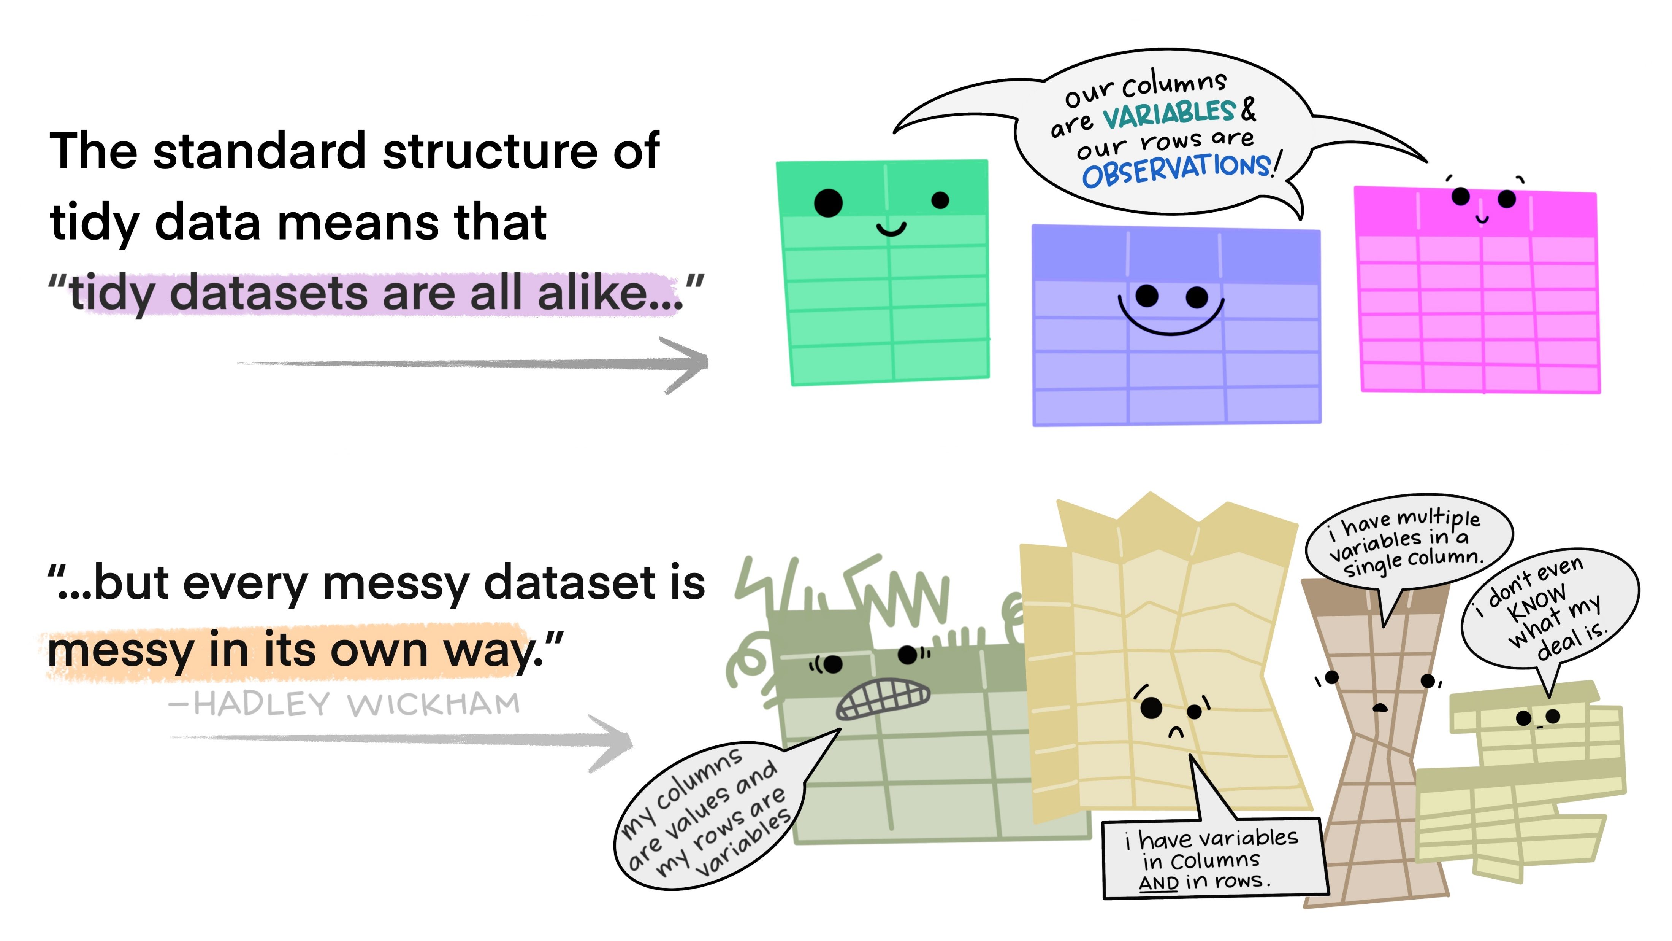
Illustrations from the Openscapes blog Tidy Data for reproducibility, efficiency, and collaboration by Julia Lowndes and Allison Horst
Notes:
Tidy data is useful because multiple datasets in a tidy format are alike.

Slide 24
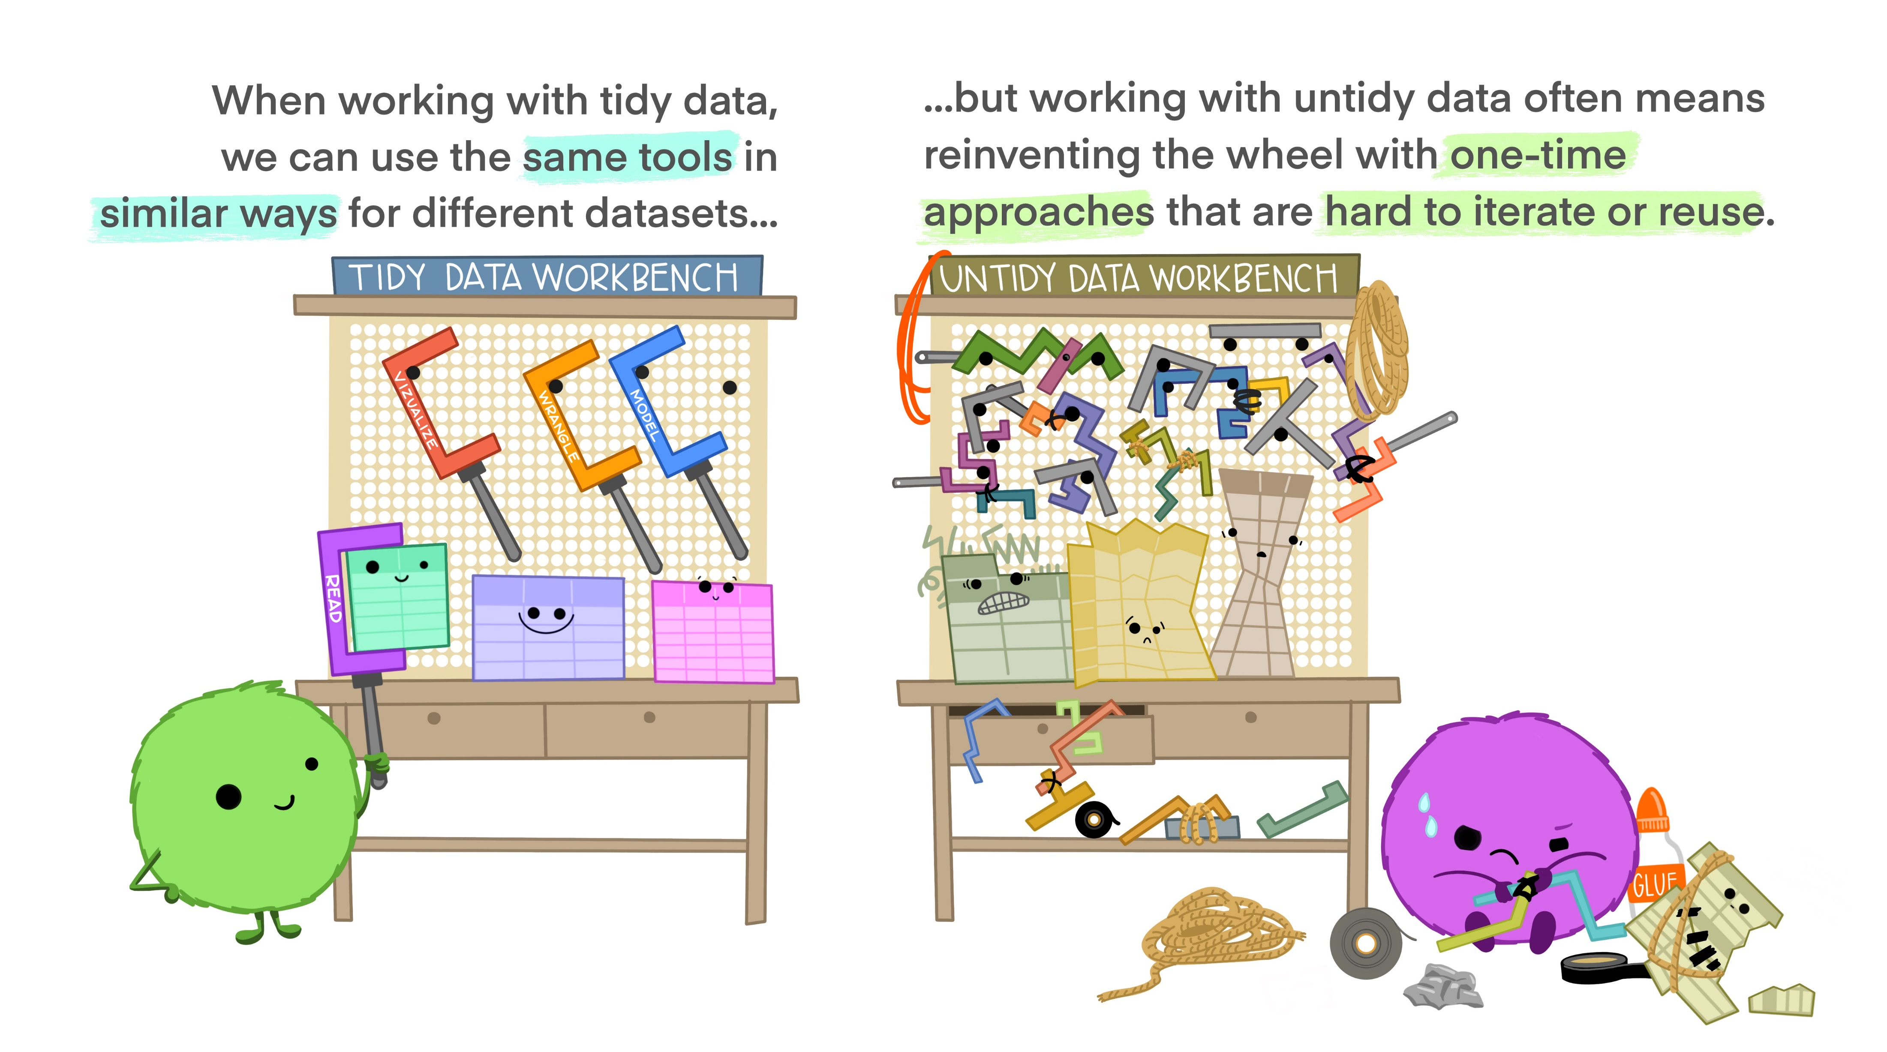
Illustrations from the Openscapes blog Tidy Data for reproducibility, efficiency, and collaboration by Julia Lowndes and Allison Horst
Notes:
This means that the same tools can be used in similar ways on tidy data sets, which is very useful. ggplot2 is easiest to use on tidy data.

Slide 25
Data Analysis – Your Turn
Notes:
https://www.online-timer.net/

Slide 26
Data Visualization Best Practices https://padlet.com/jaschilling/air_R
Notes:
Before we get into some data visualization best practices, I’d like us to use this padlet to brainstorm the answers to the following questions: what is data visualization, why visualize data, and what are qualities of effective data visualization

Slide 27
What is data visualization?

Slide 28
A Definition from Tableau
“Data visualization is the graphical representation of information and data.” (Tableau, n.d., para. 1)
Notes:
Source: What Is Data Visualization? Definition, Examples, And Learning Resources, https://www.tableau.com/learn/articles/data-visualization, para. 1

Slide 29
A Definition from Alberto Cairo
“A data visualization is a display of data designed to enable analysis, exploration, and discovery.” (Cairo, 2016, p. 31)
“A chart is a display in which data are encoded with symbols that have different shapes, colors, or proportions.” (Cairo, 2016, p. 28)
Notes:
Alberto Cairo is a journalist and designer, and the Knight Chair in Visual Journalism at the School of Communication of the University of Miami (UM). He has written several books on data visualization and information design. These quotes come from his book The Truthful Art.
Source: The Truthful Art by Alberto Cairo, p. 31 and p. 28

Slide 30
A Definition from W.E.B. Du Bois
“the rendering of information in a visual format to help communicate data while also generating new patterns and knowledge through the act of visualization itself” (Battle-Baptiste & Rusert, 2020, p. 8)
Notes:
W.E.B. Du Bois was a scholar, writer, and civil rights leader. He is well known for his activism and work in sociology. For the 1900 Paris Exposition, a world’s fair held in Paris from April to November 2020, Du Bois led a team of students and alumni at the Atlanta School of sociology to create 63 infographics about African Americans in Georgia and in the United States.
Source: W.E.B Du Bois’s Data Portraits Visualizing Black America edited by Whitney Battle-Baptiste and Britt Rusert, p. 8

Slide 31
A Definition from Tamara Munzner
“visual representations of datasets intended to help people carry out some task more effectively” (Munzner, 2011, slide 2)

Slide 32
Why visualize data?

Slide 33
Why visualize data?
Understand the data
Show patterns
Engage audience
Tell a story
Notes:
Here are some of the reasons I think visualizing data is useful. Data can be difficult to communicate and understand but when data is visualized, it is easier to understand, communicate, see patterns, and engage a viewer. Generally speaking, showing someone a table of numbers is not as impactful as showing someone a well-designed graph.
Data visualizations allow us to see the big picture and uncover insights in complex data – they make data easier to understand and absorb. Data visualizations also help people make better decisions as they can quickly see what is happening, why it is happening, and what they could do next. Data visualizations make it easier to share data and insights with others and they make it easier for people the access data as charts and graphs are often easier for people to understand than complex statistics or tables of numbers.

Slide 34
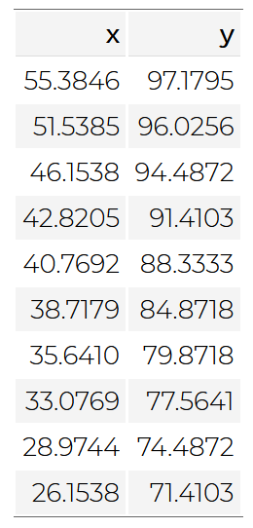
13 datasets of (x, y) coordinate pairs
Dataset ID | Mean X | Mean Y | SD X | SD Y | Corr. (x,y)
1 | 54.27 | 47.83 | 16.77 | 26.94 | -0.06
2 | 54.27 | 47.83 | 16.77 | 26.94 | -0.07
3 | 54.27 | 47.84 | 16.76 | 26.93 | -0.07
4 | 54.26 | 47.83 | 16.77 | 26.94 | -0.06
5 | 54.26 | 47.84 | 16.77 | 26.93 | -0.06
6 | 54.26 | 47.83 | 16.77 | 26.94 | -0.06
7 | 54.27 | 47.84 | 16.77 | 26.94 | -0.07
8 | 54.27 | 47.84 | 16.77 | 26.94 | -0.07
9 | 54.27 | 47.83 | 16.77 | 26.94 | -0.07
10 | 54.27 | 47.84 | 16.77 | 26.93 | -0.06
11 | 54.27 | 47.84 | 16.77 | 26.94 | -0.07
12 | 54.27 | 47.83 | 16.77 | 26.94 | -0.07
13 | 54.26 | 47.84 | 16.77 | 26.93 | -0.07
Notes:
Here is an example and some motivation for visualizing data.
In this example, there are 13 datasets of (x, y) coordinate pairs, like in the table shown on the left. Each dataset contains a series of points, each with an x and y coordinate.
If we summarize all 13 of these datasets by computing the mean and standard deviation of x and the mean and standard deviation of y, it looks like all 13 datasets are very similar. In this table, each row is one of the datasets and each column shows the summary statistics for that dataset. We can see that the mean (or average value) of the x coordinates and mean of the y coordinates are almost the same across all 13 datasets. We can also see that the standard deviation (or how spread out the values are) for x and y are almost the same as well. Finally, we can look at the correlation between x and y in each of these 13 datasets and we see that all of them have almost the same correlation, and it is very low, almost none.

Slide 35
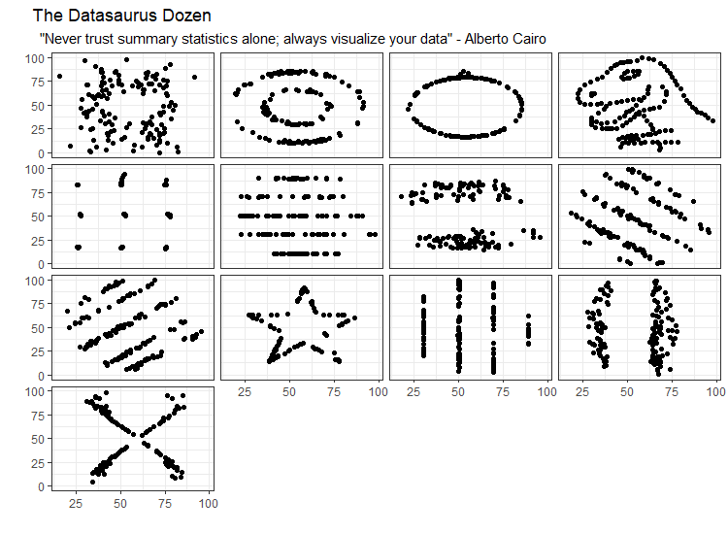
Datasets Visualized
Notes:
However, when we visualize those 13 datasets, we can see that they are all widely different from one another. When the x and y coordinates from each of the datasets are plotted, we see that even though the summary statistics are the same, they are in fact very different sets of data. These datasets were created by Alberto Cairo to show demonstrate the importance of data visualization. Data visualization is useful when exploring data for analysis and when explaining data to others.

Slide 36
What is an effective data visualization?

Slide 37
Effective Data Visualization
“The greatest value of a picture is when it forces us to notice what we never expected to see.”
(Tukey, 1977,p. vi)

Slide 38
Effective Data Visualization
“Graphical excellence is the well-designed presentation of interesting data - a matter of substance, of statistics, and of design...
[It] consists of complex ideas communicated with clarity, precision, and efficiency...
[It] is that which gives to the viewer the greatest number of ideas in the shortest time with the least ink in the smallest space...
[It] is nearly always multivariate...
And graphical excellence requires telling the truth about the data.”
(Tufte, 2001, p. 51)

Slide 39
Effective Data Visualization
“Ultimately, it is content that makes graphics interesting. When a chart is presented properly, information just flows to the viewer in the clearest and most efficient way. There are no extra layers of color, no enhancements to distract us from the clarity of the information.”
(Wong, 2010, p. 13)

Slide 40
Effective Data Visualization
“A good visualization is:
reliable information,
visually encoded so relevant patterns become noticeable,
organized in a way that enables at least some exploration, when it’s appropriate,
and presented in an attractive manner, but always remembering that honesty, clarity, and depth come first.”
(Cairo, 2016, p. 12)
Notes:
Alberto Cairo also says that the five qualities of great visualizations are that they are Truthful, Functional, Beautiful, Insightful, and Enlightening (Cairo, 2016, p. 45)

Slide 41
Effective Data Visualization
“The effectiveness of any particular graph is not just a matter of how it looks in the abstract but also a question of who is looking at it, and why.”
(Healy, 2019, p. 1)
“A good visualization can do more than just answer questions; it can help you see that there are other questions you need to answer.”
(Wexler, 2021, p. 2)

Slide 42
Effective Data Visualization
“Rather than making universal rules and ratios that exclude some aspects of human experience in favor of others, our time is better spent working toward a more holistic and more inclusive ideal. All design fields, including visualization and data communication, are fields of possibility.
Rebalancing emotion and reason opens up the data communication toolbox and allows us to focus on what truly matters in a design process: honoring context, architecting attention, and taking action to defy stereotypes and reimagine the world.”
(D’Iganzio & Klein, 2020, p.96)

Slide 43
BREAK
Notes:
https://www.online-timer.net/

Slide 44
What do you need to know to visualize data?
Preattentive Attributes
Gestalt Principles
Color Use in Data Visualization
Types of Data Visualizations
Hierarchy of Perceptual Tasks
Notes:
Now that we know what data visualization is, why we might want to use it, and what the qualities are of effective data visualization, what do you need to know to visualize data.
Here are five key topics we will discuss next that are useful to understand when visualizing data. First, we will talk about Preattentive Attributes, which are visual encodings that our brains process without our conscious awareness. Next, we will talk about the Gestalt Principles of Visual Perception, which were established by the Gestalt School of Psychology in the early 1900s based on research of how people interact with and create order from visual stimuli. Then, we will discuss some basic color principles and how to decide which type of data visualization to use. Finally, we will cover the hierarchy of perceptual tasks.
By understanding these five topics, we can create effective data visualizations that are easy for the audience to understand and engage with. The goal of using these concepts is to reduce the cognitive load of the data visualization so that the viewer does not have to work so hard to understand it.
Prior Knowledge Check: Have you heard of the Preattentive Attributes or Gestalt Principles before? [POLL]

Slide 45
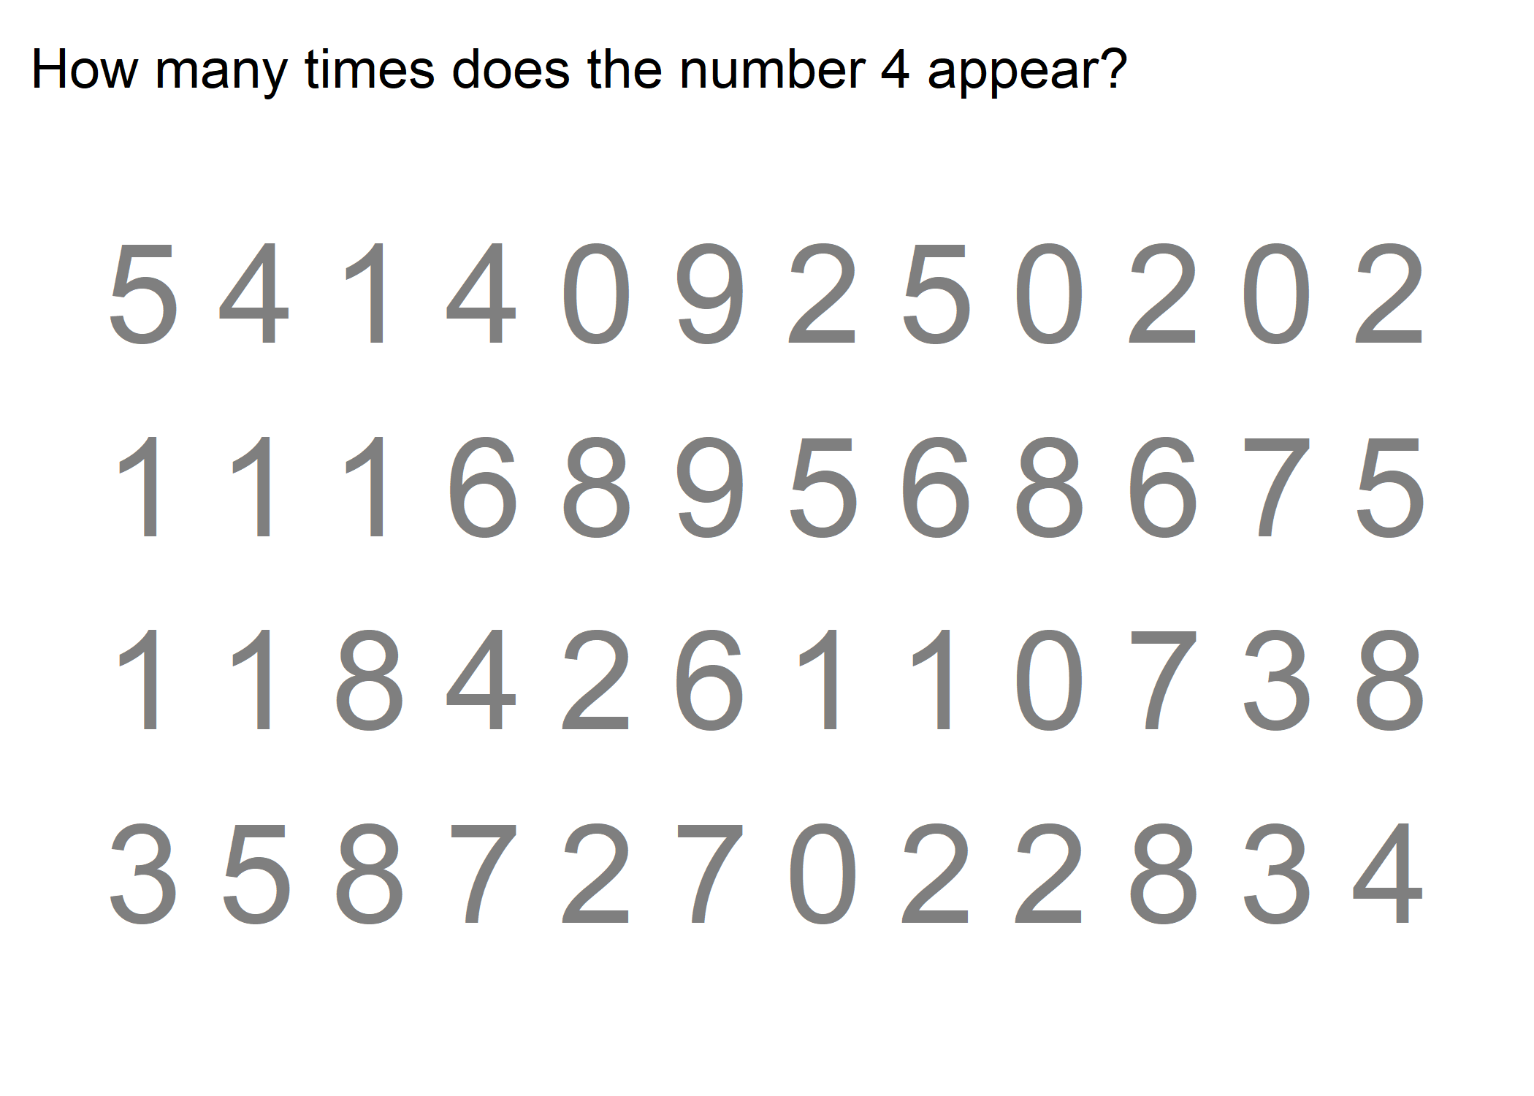

Slide 46
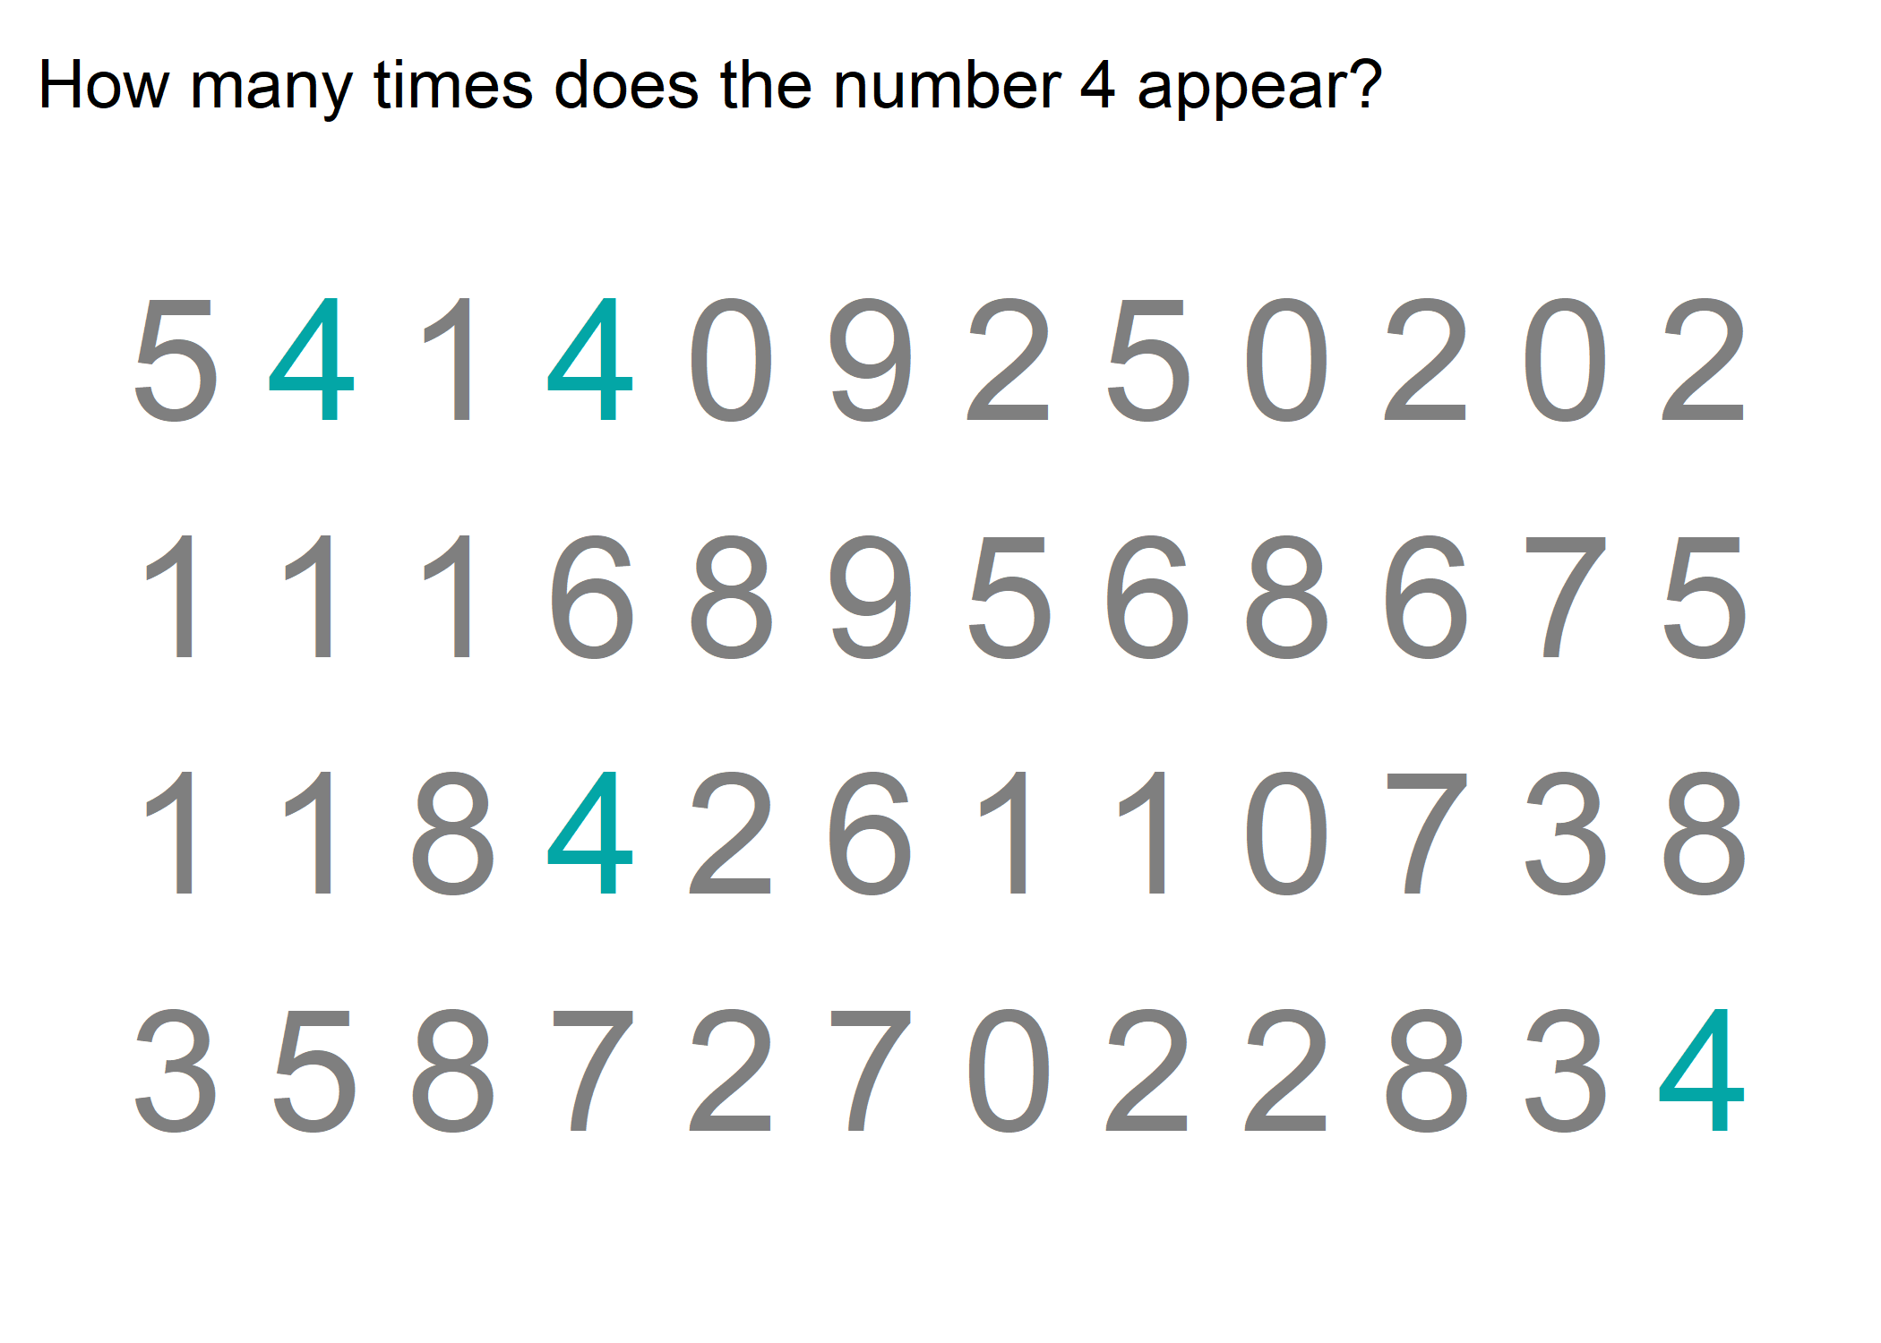

Slide 47
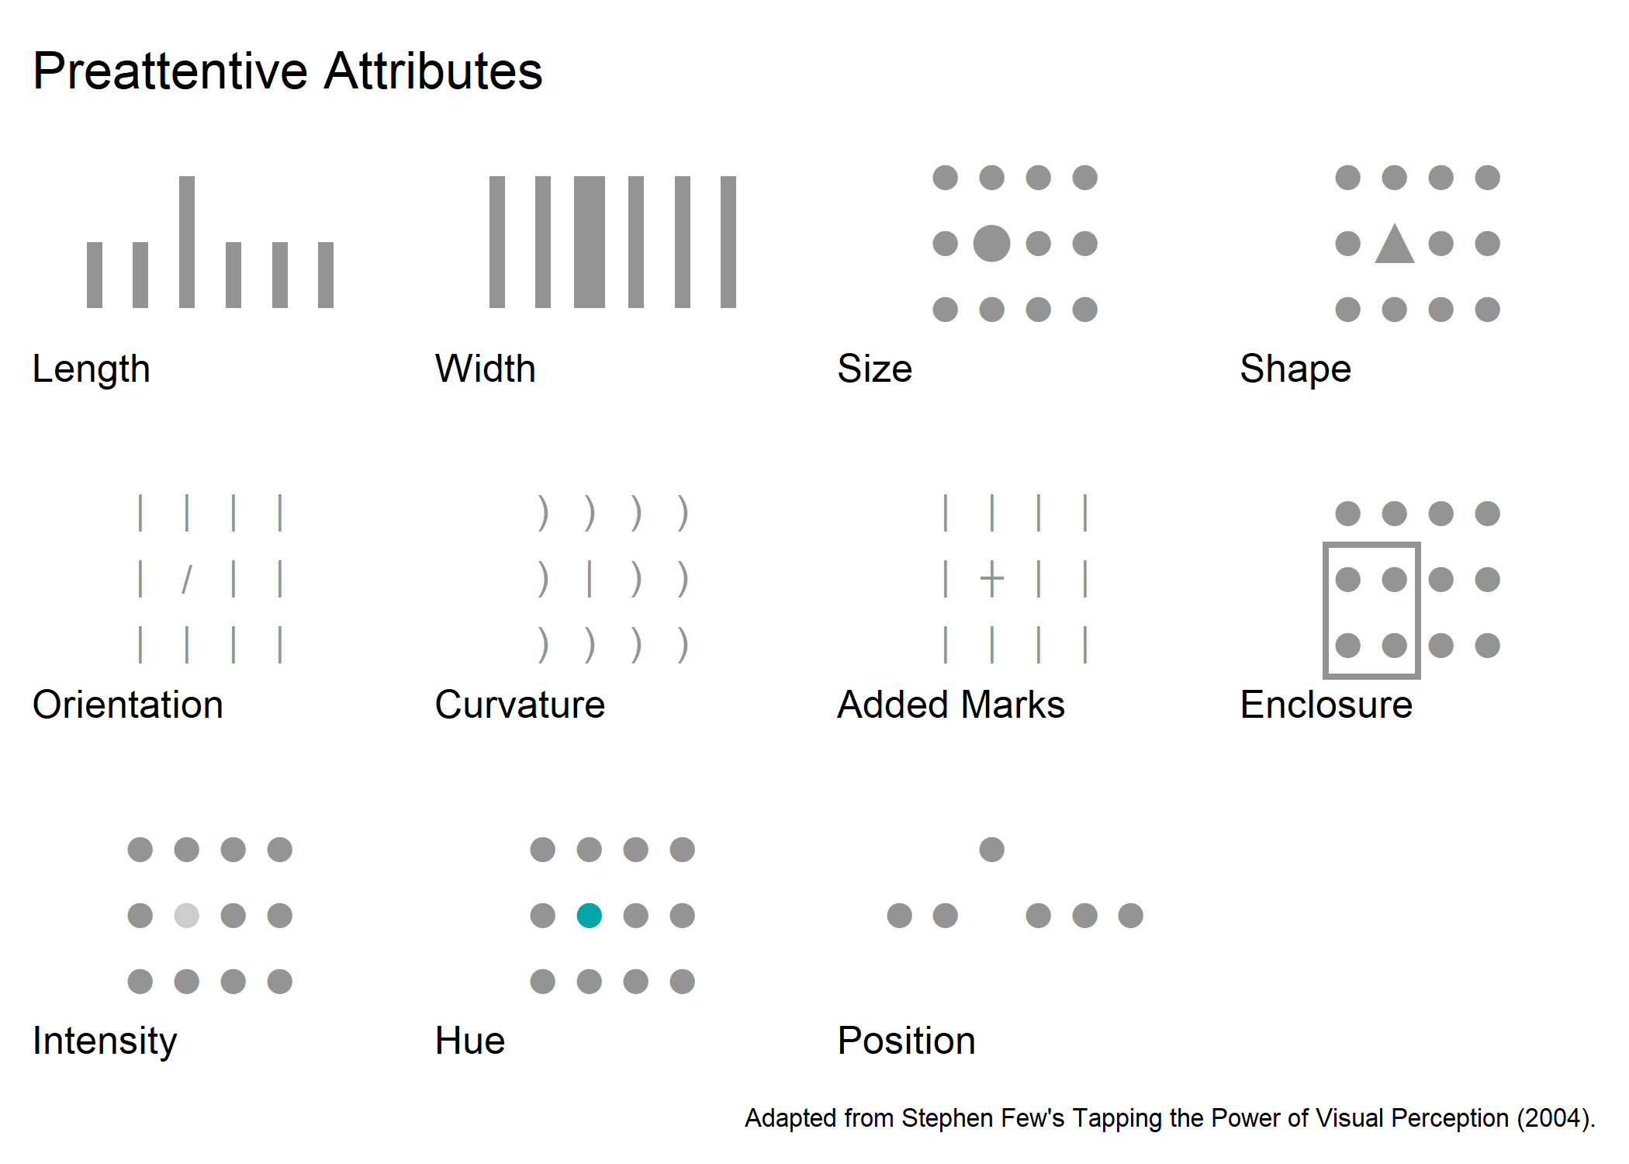
Notes:
Preattentive attributes can be used to help people understand data, focus the viewer’s attention, and create a visual hierarchy. They can be used to put emphasis on the most important pieces of data by providing visual cues that will automatically draw the viewer’s attention. Preattentive attributes “help us enable our audience to see what we want them to see before they even know they’re seeing it” (Knaflic, 2015, p. 104).
Here are eleven preattentive attributes: length, width, size, shape, orientation, curvature, added marks, enclosure, intensity or saturation, hue, and position. In each example, you will immediately see the element that is different whether it is longer, a different shape, oriented differently, has an extra mark, or is a different color. Your eye is drawn to it – you don’t even have to search for it. This is “because our brains are hardwired to quickly pick up differences we see in our environments” (Knaflic, 2015, p. 105).
Length - an object of a different length stands out; this can be seen in column charts and bar charts
Width - an object of a different width stands out; this can be seen in treemaps and 100% stacked column charts
Size - an object of a different size stands out; this can be seen in bubble charts
Shape - an object of a different shape stands out; this can be seen in scatterplots
Orientation - an object of a different orientation stands out; this can be seen in line charts and in comparing column charts and bar charts
Curvature- an object of a different curvature stands out; this can be seen in line charts
Added Marks - an object with additional marks or lines stands out; this can be seen in scatterplots
Enclosure - an object with a border or shaded area stands out; this can be seen in tables and small multiple charts
Intensity - an object with a different intensity or saturation stands out; this can be seen in heatmaps and shaded tables
Hue - an object with a different hue or color stands out; this can be seen in grouped column charts and any chart with a data point highlighted
Position - an object in a different position stands out; this can be seen in scatterplots
I want to talk briefly about enclosure before we move on, enclosure can be used to either frame or shade a section of a table or graph to draw attention to it or help the viewer group the enclosed elements together. This can be particularly useful when we want to draw a distinction in the data. For example, if a graph displays actual values and forecasted values, we could shade the area of the graph with the forecast to help the viewer separate the actual values from the forecasted values. Enclosure is also a Gestalt Principle
While we won’t discuss it in much detail, preattentive attributes can also be used in text. Examples include bold and italics font, color, font size, line spacing, outline, and underline.
Source: Storytelling with Data by Cole Nussbaumer Knaflic

Slide 48
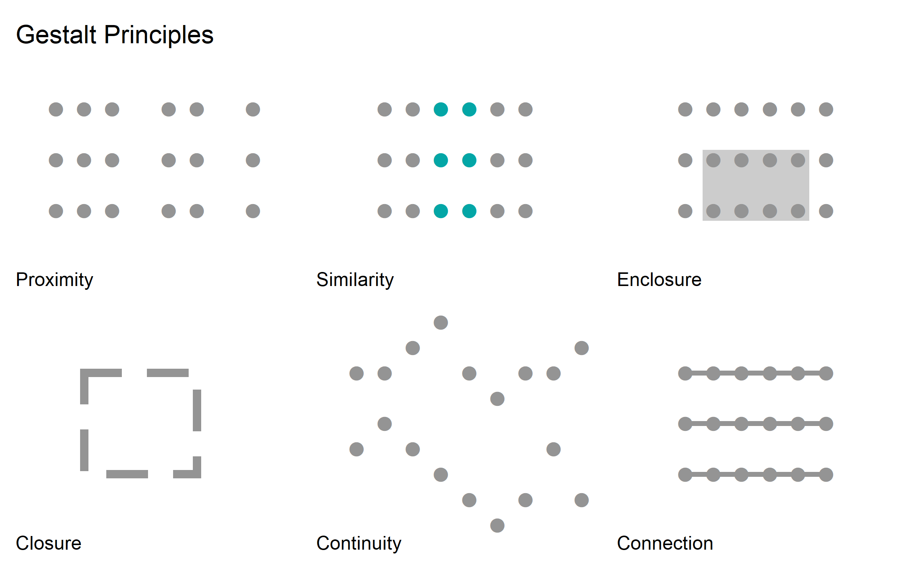
Notes:
The Gestalt Principles of Visual Perception were established by the Gestalt School of Psychology in the early 1900s based on research of how people interact with and create order from visual stimuli. The psychologists involved with the research theorized that we tend to group elements, look for patterns, and reduce complex images to their simplest form.
We can use the Gestalt Principles to design data visualizations that will help the viewer more easily understand them. When we implement these principles in data visualization, we can reduce the cognitive load or the amount of processing the viewer must take on to understand the data because the principles are based on how people naturally interpret and process visual elements.
Proximity – elements that are close together are thought of as belonging to a group; this can be used in table design by adding more space between rows or more space between columns to help the viewer easily see the table. In the example on the slide, we can see three columns and three rows. This principle also applies in scatter plots because we will naturally find groups of data that are close together – those groupings may or may not be meaningful but our brain will interpret them as groups, nonetheless.
Similarity – elements that look similar are thought of as belonging to a group – they may be similar color, shape, or size; again, this can be used in table design by shading alternate rows. It can also be used in plotting data by making data points of different categories different colors or shapes. Notice that due to proximity, in the example, we can also see three rows of circles.
Enclosure – elements that are physically enclosed are thought of as belonging to a group; this is also a preattentive attribute and as we discussed earlier can be used to distinguish groups in a dataset
Closure – the brain fills in gaps to create a recognizable image; we perceive the whole before the parts; this can be used to remove borders and backgrounds from charts because the brain will perceive the whole chart together without the additional elements like borders or backgrounds; removing extra elements such as a border around a chart allows the data to stand out more
Continuity – elements that are ordered in a line or curve are thought of as belonging to a group; we look for the smoothest path and naturally create continuous lines; this can be used to remove axis lines in a bar graph because the brain will perceive all the bars to be lined up; this principle also applies in scatterplots because our brains will follow a continuous path between points, again whether or not it is meaningful
Connection – elements that are physically connected are thought of as belonging to a group; connection is a powerful association; it can be seen in data visualization in line graphs
One important thing to note about the Gestalt Principles, and how we view data in general, is that we are always looking for structure and relationships. It’s important to keep this in mind as we design data visualizations because our viewers will look for structure and relationships whether or not they are actually there.
Of course, there is interpretation involved when viewing data visualizations that extend beyond these immediate perceptions. But it’s important to understand the preattentive attributes and gestalt principles because they influence a person’s initial engagement with a data visualization. We can use these to highlight important information, draw attention to a certain area of the visualization, and create a hierarchy of visual elements. Using the preattentive attributes and gestalt principles well can also help reduce the cognitive load of processing a data visualization.

Slide 49
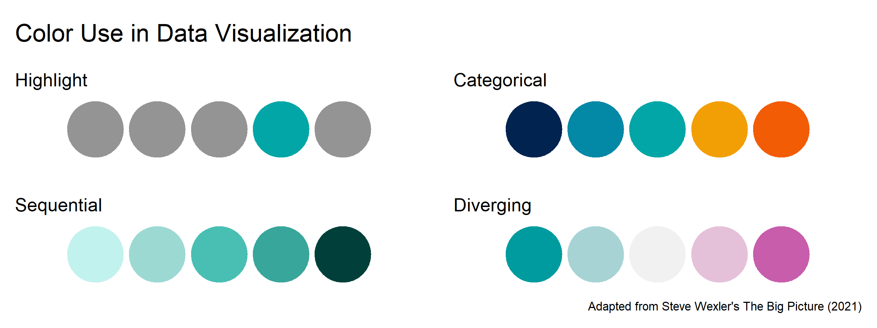
Notes:
We have already seen how color can be used to draw attention, highlight information, or group data points together. Now let’s talk more specifically about the main uses of color in data visualization.
When used in a data visualization or dashboard, color should have clear purpose and be consistent and accessible. If one color is used to indicate a specific category, it should be used consistently each time that category is included. If one color is used to highlight an important datapoint, it should be used for highlighting across visualizations. Consistency helps the viewer make meaning from the use of color and makes it easier for them to understand the important information.
Color should be used with a purpose and should not be arbitrarily added to data visualization. Using too many colors defeats the purpose of associating numbers with colors. Research shows that most people’s short-term memory will only retain up to five pieces of information at one time. The more colors you use to represent your data the harder it becomes to read it quickly. If you need more than five colors in your chart, consider using an alternate chart type.
Now, let’s talk about the different ways color can be used in a data visualization.
First, as we’ve already discussed, color can be used to highlight a datapoint or to bring the viewer’s attention immediately to it.
Second, color can be used to designate different categories or labels. It can be used to help the viewer differentiate between different groups of data points.
Third, color can be applied to quantitative values either in a sequential or diverging manner. Sequential color is used to show low to high values on a continuous scale. Diverging color is used to show values above or below a midpoint on a continuous scale.
Keep in mind that we should only add color when it adds meaning and helps with understanding.
Now we are going to take a quick look at an example of using color in a bar graph. I will show a graph briefly and then ask what message or meaning you were able to establish.

Slide 50
How do you know which chart to use?
“When it comes to selecting a graph, first and foremost, choose a graph type that will enable you to clearly get your message across to your audience.” (Knaflic, 2015, p. 60)
“The purpose of your graphics should somehow guide your decision of how to shape the information.” (Cairo, 2016, p. 51)
Notes:
[DISCUSSION] How do you know which chart to use?
Some charts are more effective than others in certain applications, and as we saw in the last session, there are some ways that we process visual information that make certain visual representations easier to process than others. Determining which chart to use depends on the data, the audience, and the purpose for creating the visualization.
Cole Nussbaumer Knaflic says “when it comes to selecting a graph, first and foremost, choose a graph type that will enable you to clearly get your message across to your audience” (2015, p. 60). She recommends that you begin with thinking about what you want your audience to know and then pick a chart that will make the message clear and easy for the audience to read and understand (Knaflic, 2015).
Alberto Cairo also recommends considering the message and goals for a visualization (Cairo, 2016). He says, “the purpose of your graphics should somehow guide your decision of how to shape the information” (Cairo, 2016, p. 51). He suggests asking questions like “What tasks should the graphic enable?” and “What should I reveal with it?” (Cairo, 2016, p. 138). Cairo also reminds us that “the way data is visually presented has very real consequences on the lives of people who read your visualizations” (2016, p. 148).
This is helpful to keep in mind – we should think about the audience, the task or goal we are trying to achieve, and the type of data as we decide which chart to use. Now we will take a look some different groups of charts based on the tasks they enable.
Other Notes:
“What do you need your audience to know?” Choose a “visual display that will enable you to make this clear” (Knaflic, 2015, p. 69).
“What is the right graph for my situation?” “Whatever will be easiest for your audience to read.” (Knaflic, 2015, p. 69)

Slide 51
Resources
From Data to Viz
Depict Data Studio – Chart Chooser
Visual Vocabulary

Slide 52
Perceptual Tasks
Notes:
Perceptual tasks are the steps we need to take to interpret a visualization – to extract the real value represented in the visual.
We are going to look at three different visualizations and attempt to determine or extract the value of a particular piece of the chart. Please put your guess in the chat as a I show each slide.

Slide 53
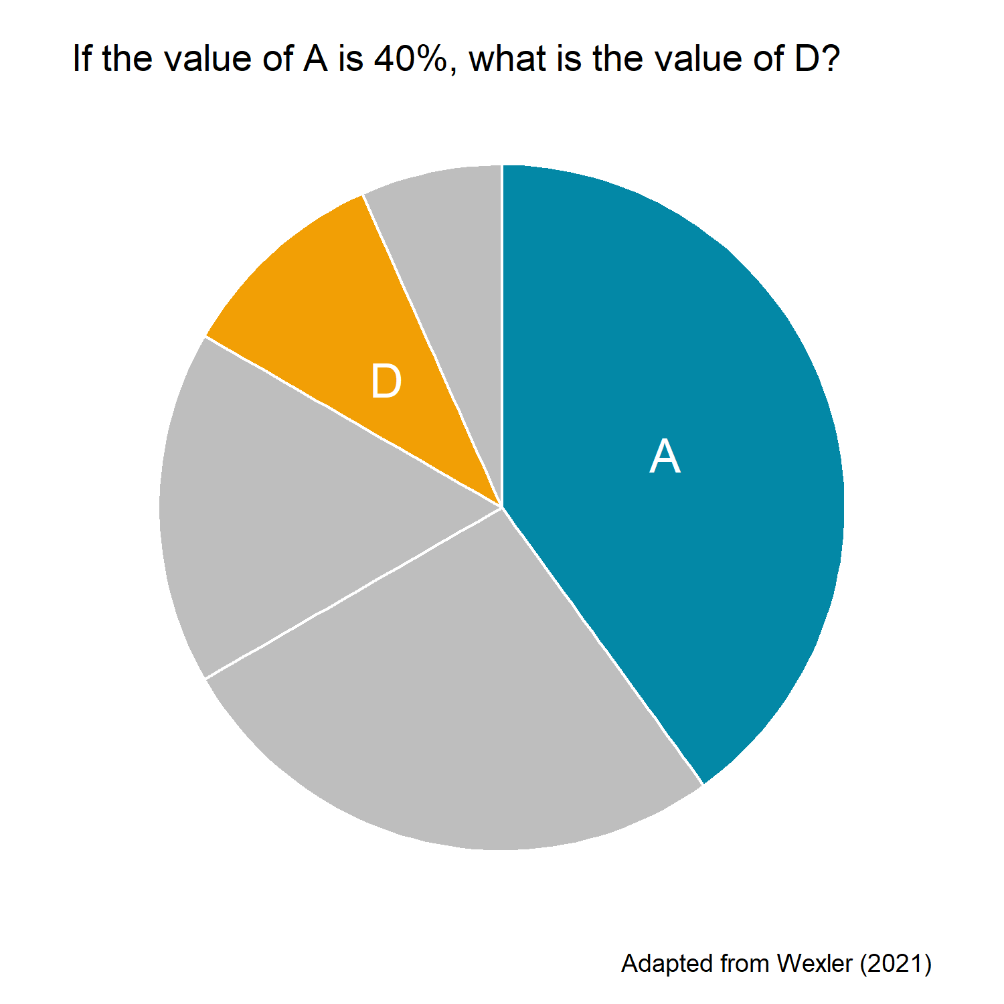
Perceptual Tasks
Notes:
First, is this pie chart. If the value of A is 40% what is the value of D?
D is 10%

Slide 54
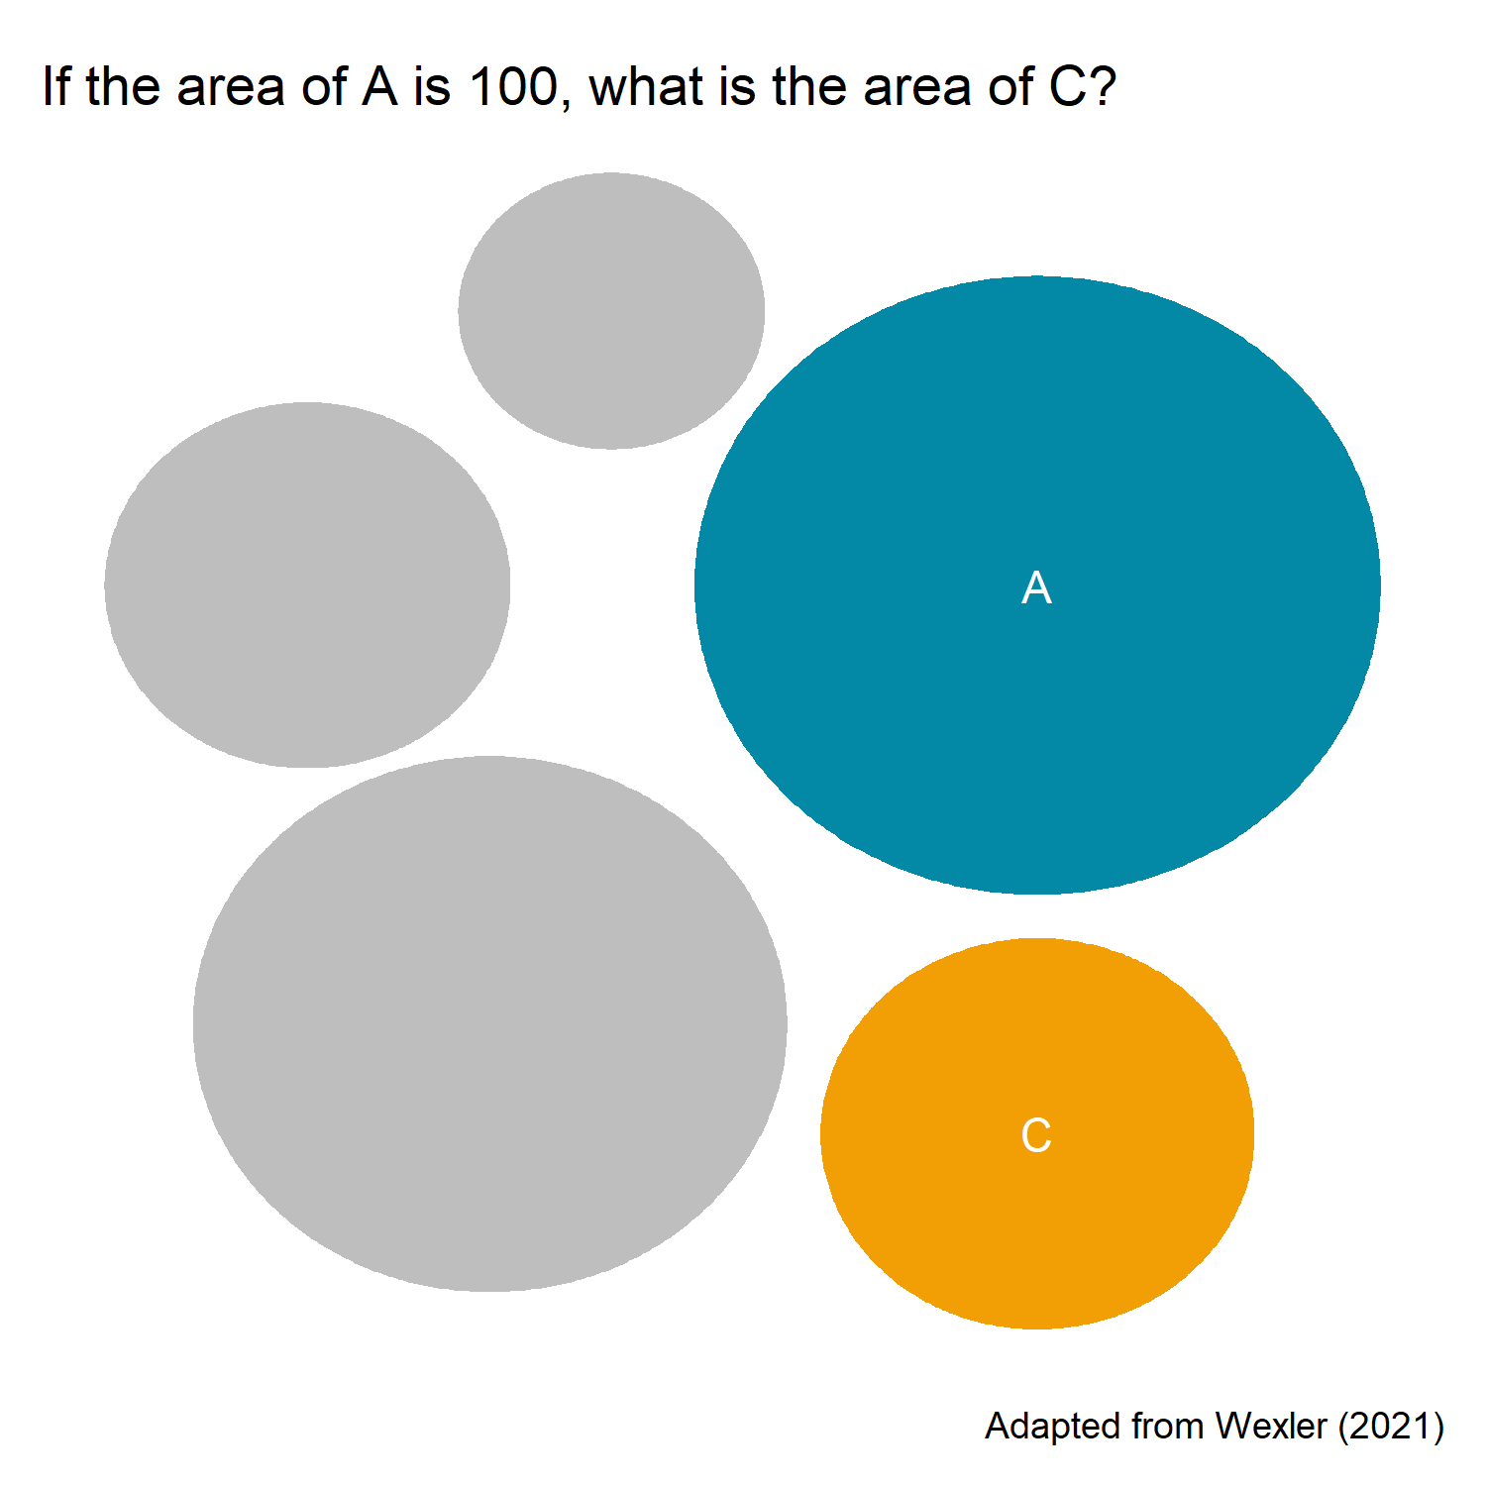
Perceptual Tasks
Notes:
Next an area chart, if the area of A is 100 what is the area of C?
C is 40

Slide 55
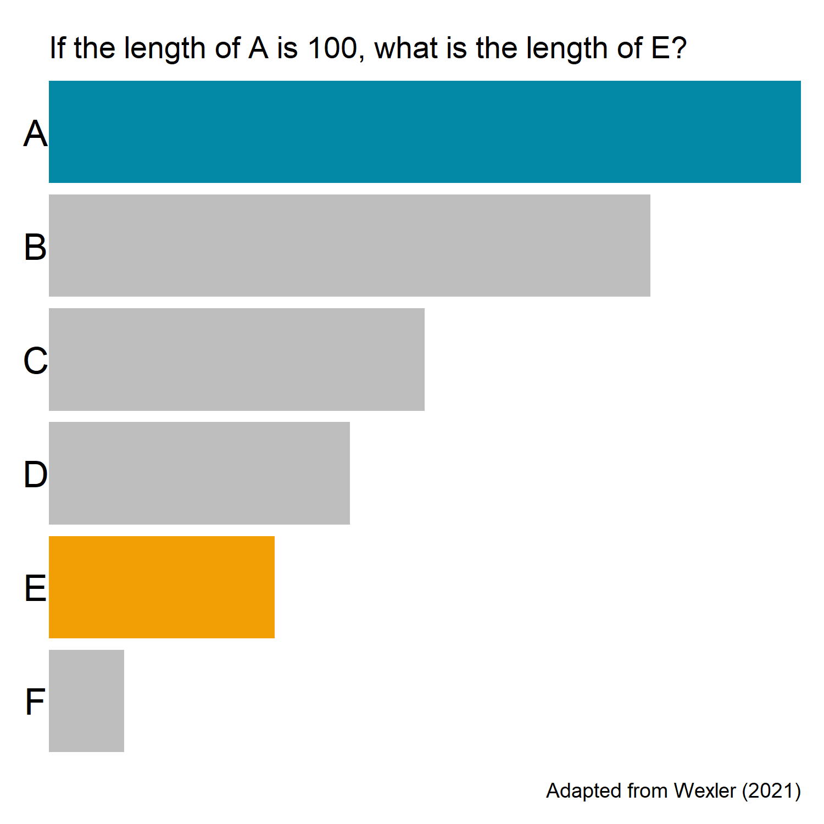
Perceptual Tasks
Notes:
Finally, a bar chart, if the length of A is 100, what is the length of E?
E is 30

Slide 56
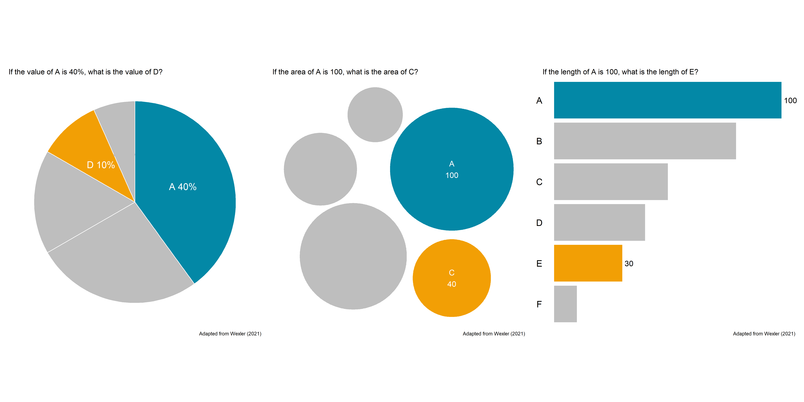
Perceptual Tasks
Notes:
How did you do?

Slide 57
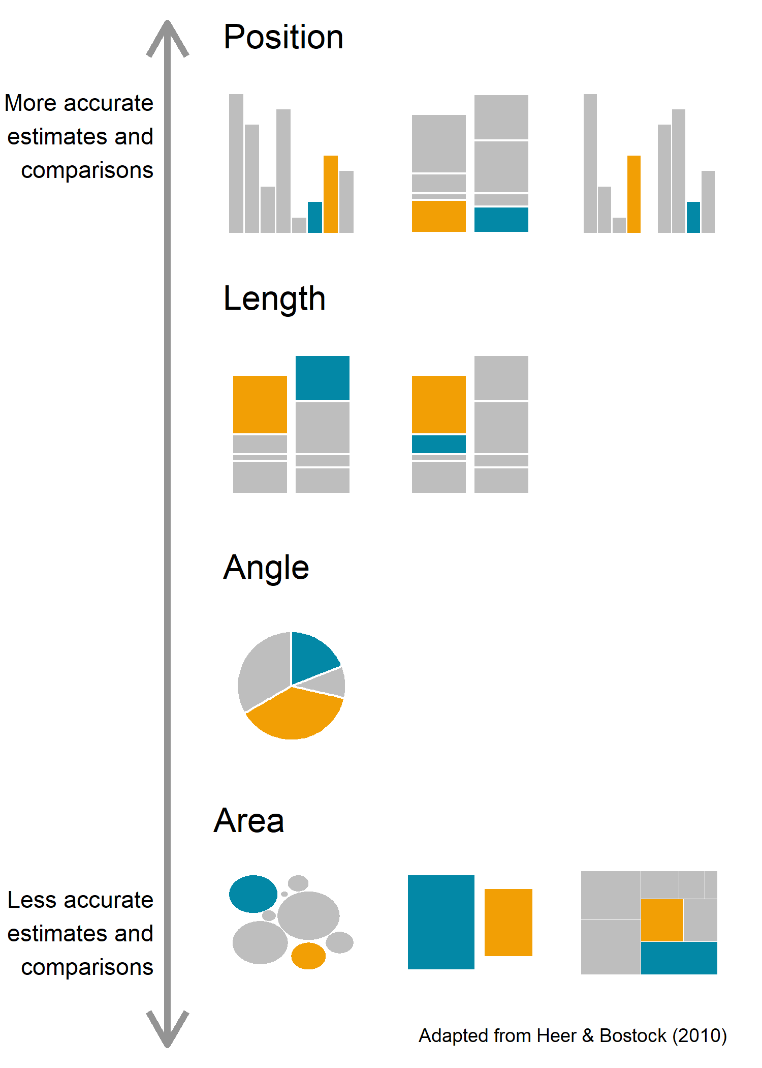
Perceptual Tasks
Notes:
William S. Cleveland and Robert McGill conducted experiments in the 1980s to determine how well people can estimate and compare two values in a chart across different chart types. Jeffrey Heer and Michael Bostock replicated and expanded these experiments in 2010, and research continues today to evaluate how well different chart types perform for comparison and estimation of values.
Based on the research from Cleveland and McGill and Heer and Bostock, position allows for more accurate estimates and comparison while area results in less accurate estimates and comparisons.
This is useful to know because if we are trying to create visualizations that allow for accurate estimates and comparisons by the audience, we should use visual encodings at the top of this hierarchy and stay away from those at the bottom of the hierarchy.

Slide 58
Data Visualization in R

Slide 59

Data Visualization in R
Library: ggplot2
Robust
Iterative
Flexible
Functional
Reproducible
Notes:
To build data visualizations in R, we will use the ggplot2 package, which is part of the tidyverse collection of packages. I really like ggplot2 and creating data visualizations in R because I find it to be a robust process that is easy to iterate on. It is flexible and it is certainly very functional. Using ggplot2 also allows graphs and plots to be reproduced since they are entirely created by code.

Slide 60
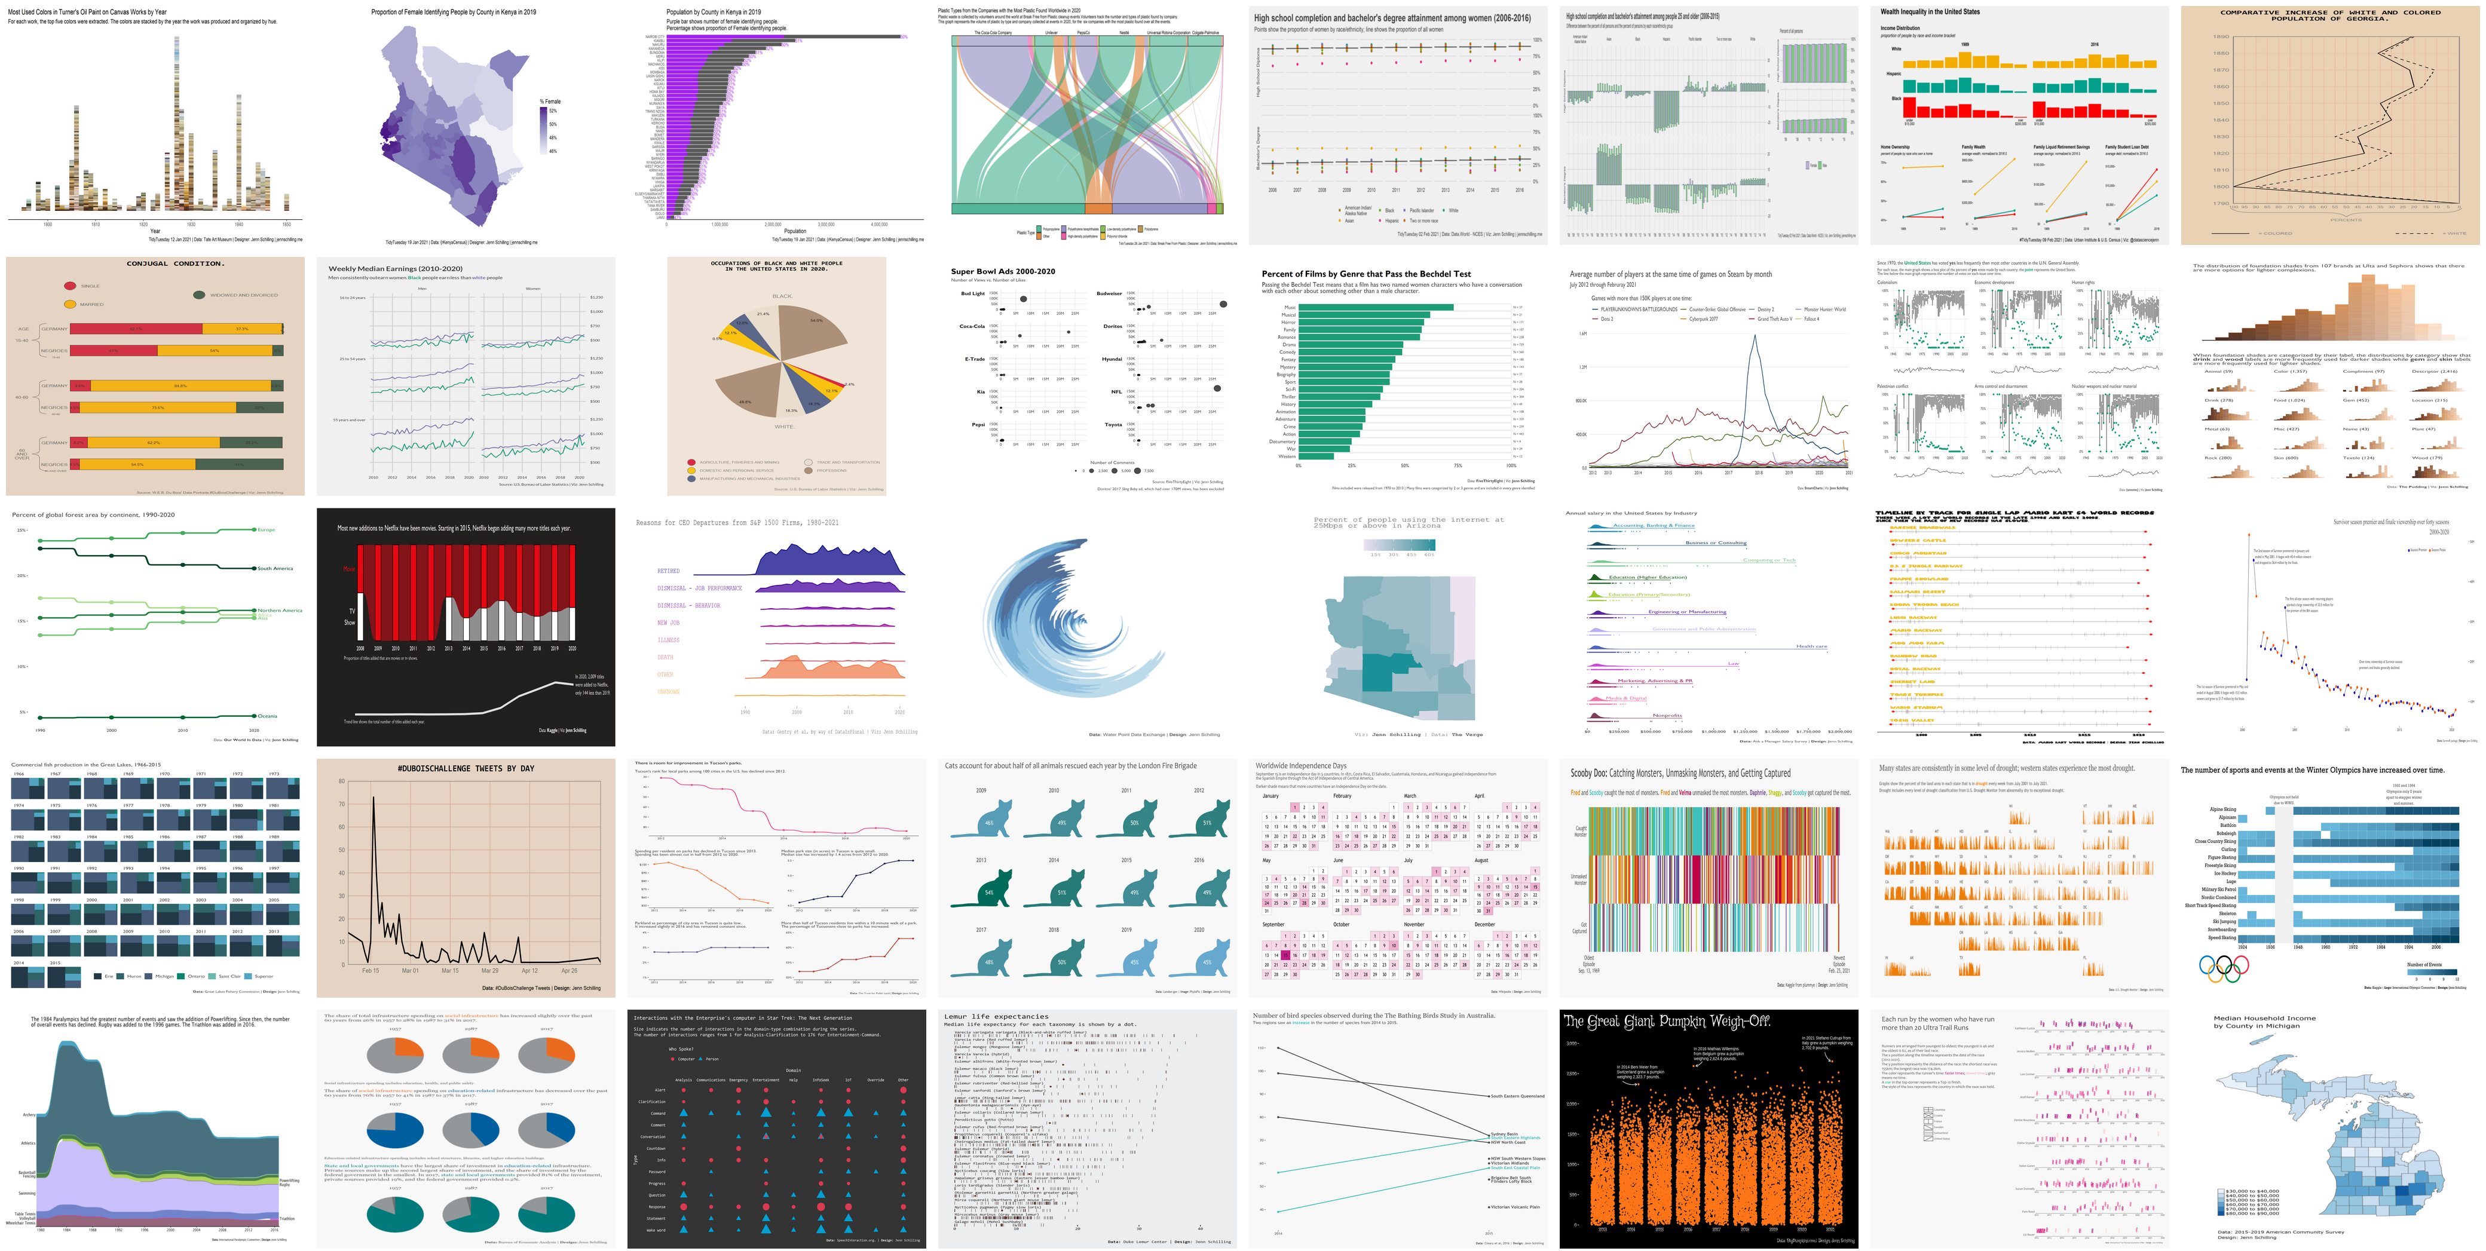
What’s Possible with ggplot2?

Slide 61
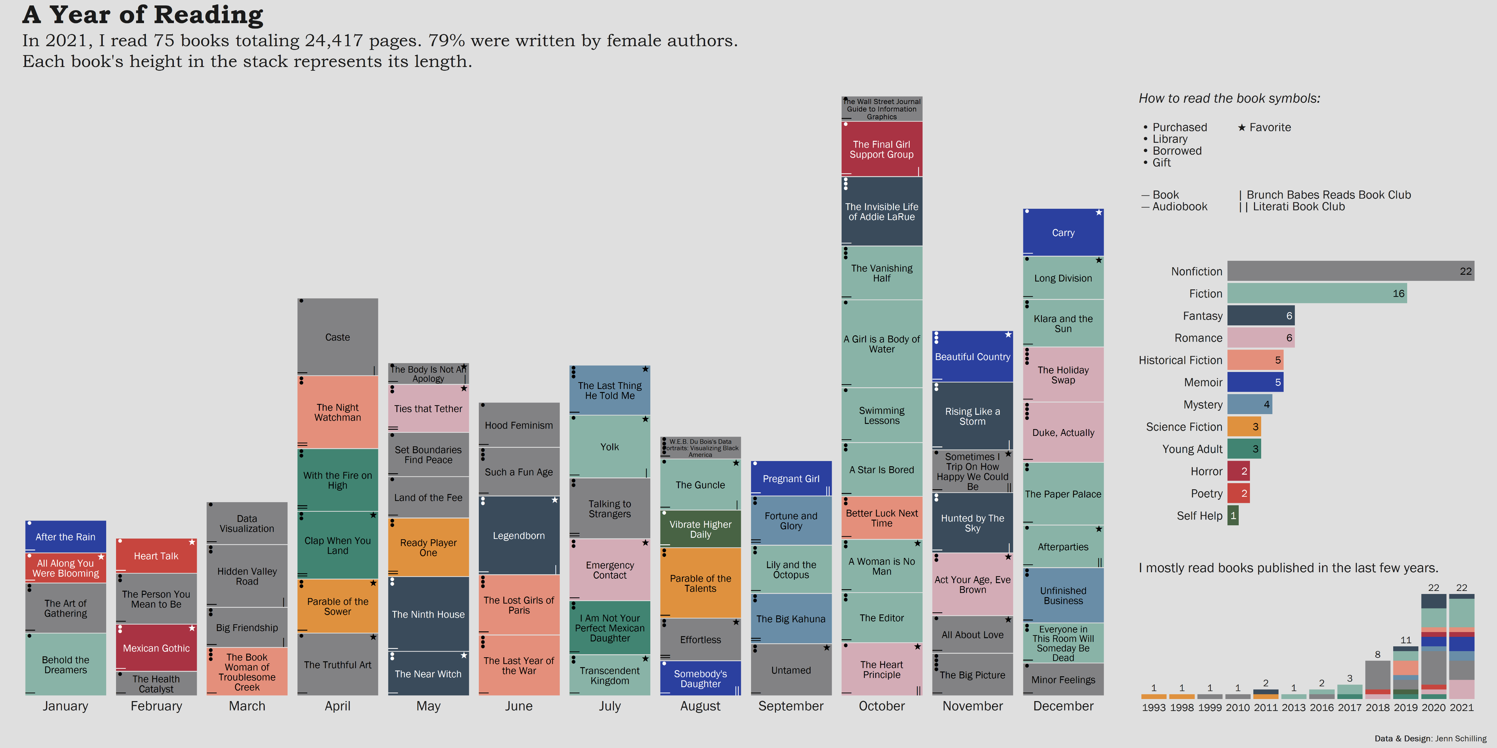
What’s Possible with ggplot2?

Slide 62
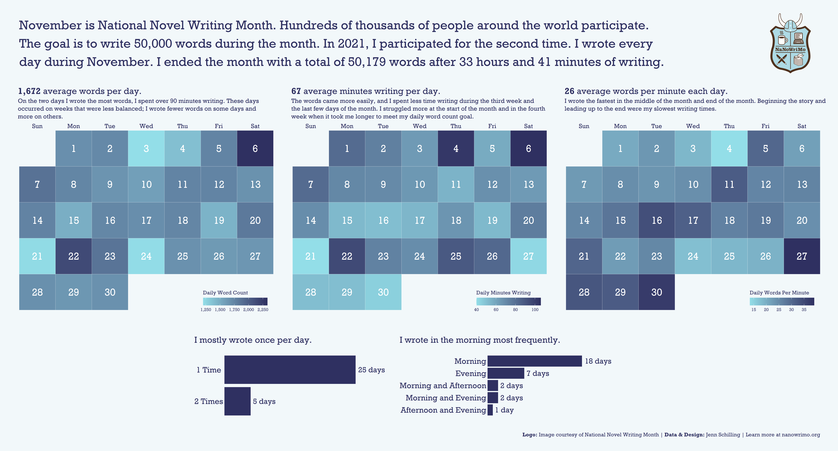
What’s Possible with ggplot2?

Slide 63
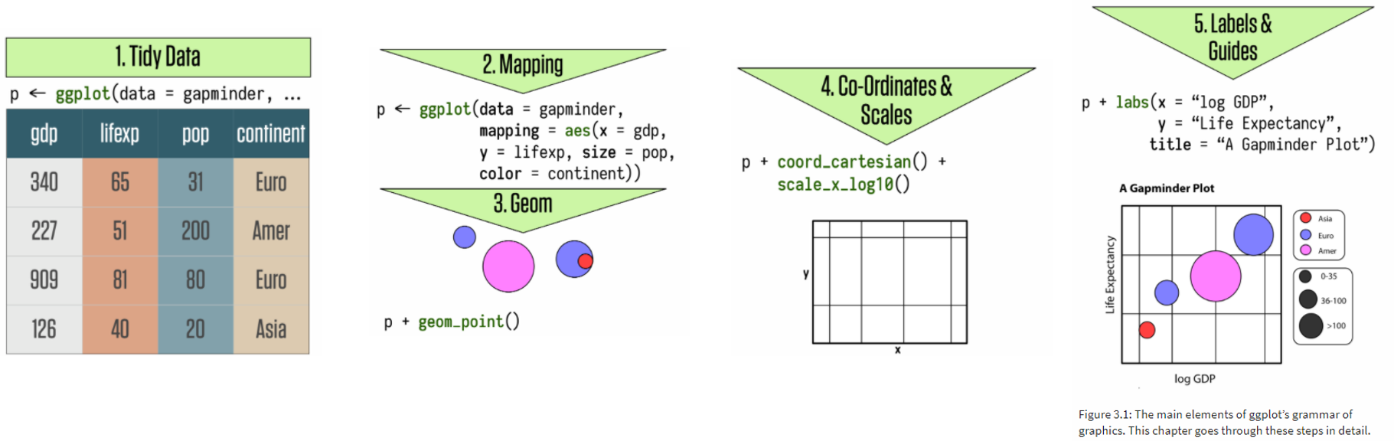
The Grammar of Graphics
The basis of ggplot2
Build plots in layers:
Data to be visualized
Aesthetic mappings
Geometric objects
Statistical transformations
Coordinates
Scales
Facets
(Wickham, 2010, p. 8; Healy, 2019, p. 56)
Notes:
ggplot2 is built as a grammar of graphics. The gg stands for grammar of graphics and forms the basis of the methodology in ggplot2. The idea is to build plots up layer by layer and specify the different pieces of plot as you go. Starting with the data to be visualized, the user defines aesthetic mappings that define how the data will be mapped to plot elements, such as x and y. Then geometric objects are added on to define how those plot elements will be displayed, for example as points or lines. It is possible to make statistical transformations of the data when it is plotted, although we won’t be covering that in this webinar. The coordinate system can be defined in ggplot2 as well as the scales that are used on the axes and colors. Faceting allows small multiple plots to be developed that show plots by groups. Finally, labels and legends can be added and customized.
Wickham, H. (2010). A layered grammar of graphics. Journal of Computational and Graphical Statistics, 19(1), 3-28. Retrieved March 7, 2021, from http://vita.had.co.nz/papers/layered-grammar.pdf
Healy, K. (2019). Data visualization: A practical introduction. Princeton, NJ: Princeton university press.

Slide 64
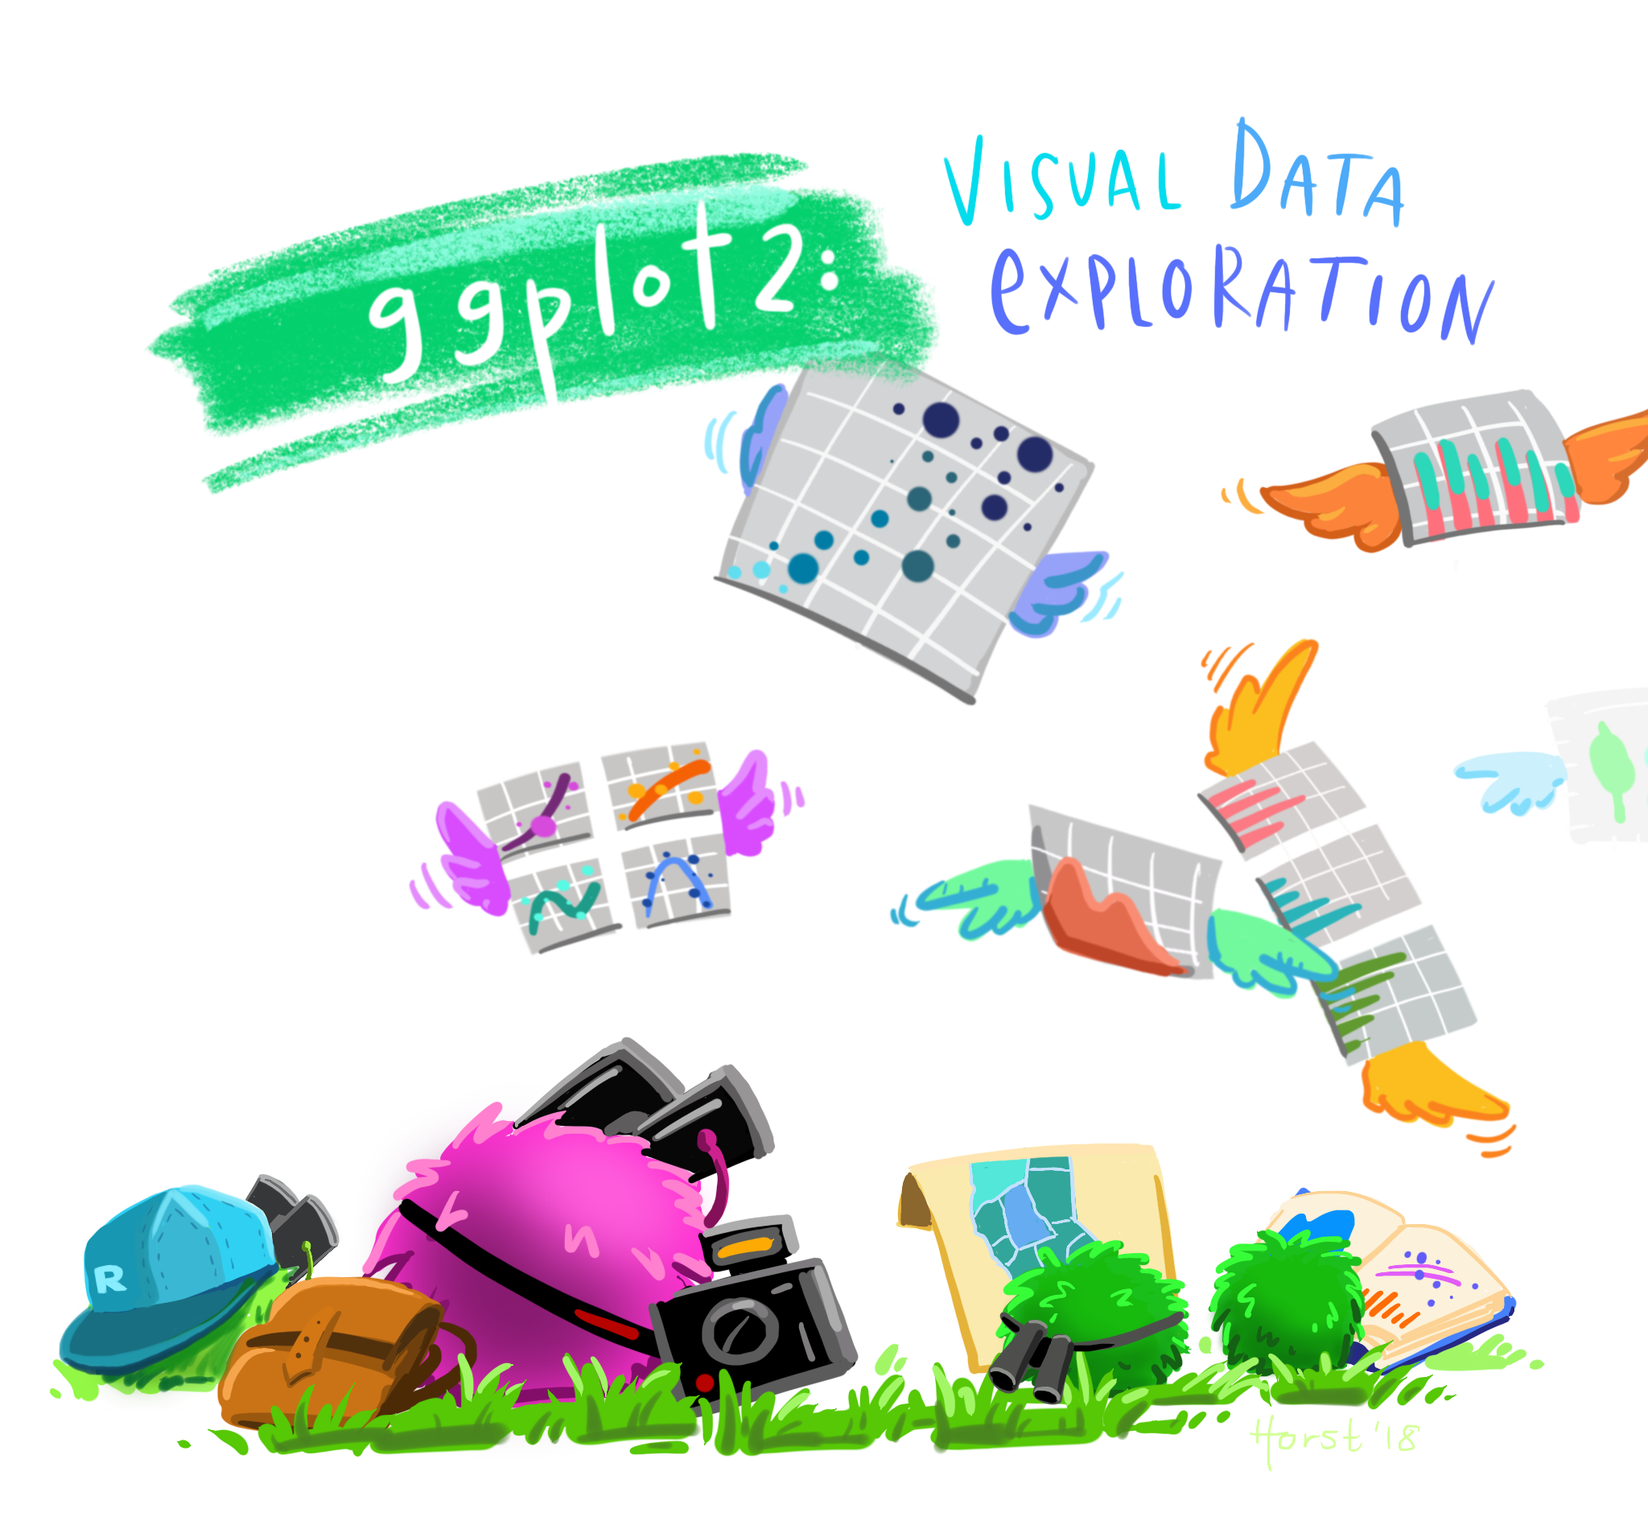
Artwork by @allison_horst
Notes:
ggplot2 can be used to complete visual data exploration. Once you get the hang of it, it’s very easy to quickly generate rough plots to explore your data.

Slide 65
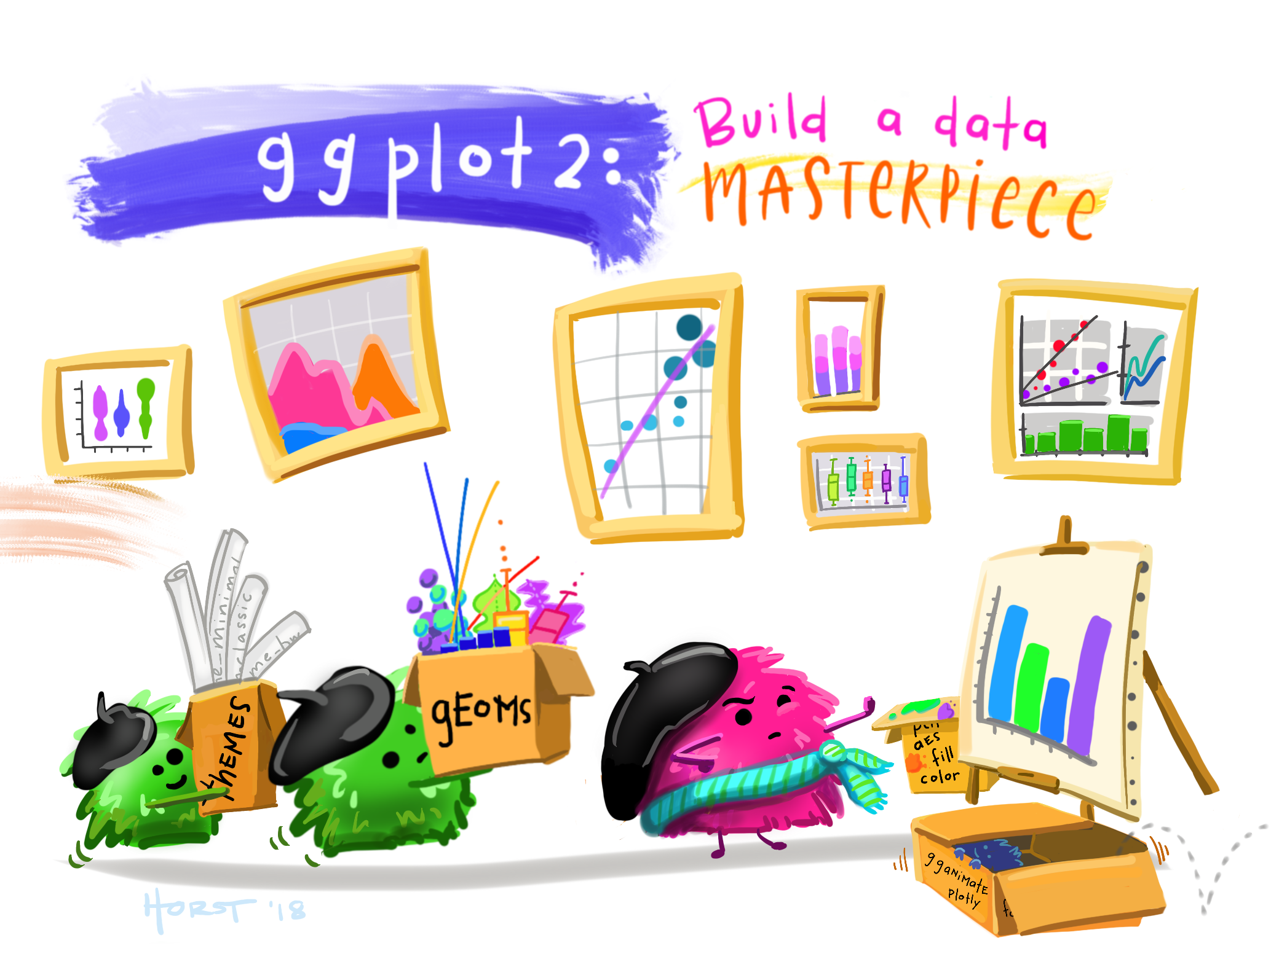
Artwork by @allison_horst
Notes:
ggplot2 can also be used to create well designed and engage data visualizations and infographics. It’s flexibility allows for almost endless customization.

Slide 66
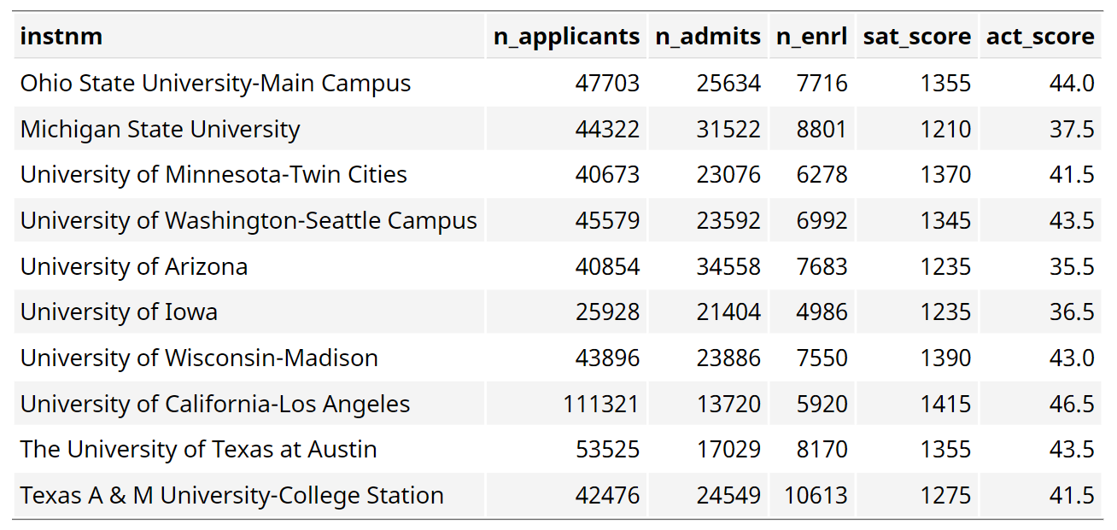
Plotting in R – Tidy Data (inst_adm_plot)
Notes:
For 2019, the SAT and ACT scores by institution, along with the number of applicants, number of admits, and number of students who enrolled.

Slide 67
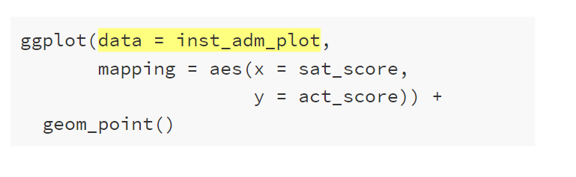
Plotting in R – Data
Notes:
Within the ggplot() function, we set the data argument

Slide 68
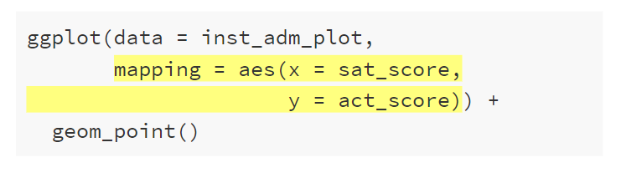
Plotting in R – Aesthetic Mappings
Notes:
Within the ggplot() function, we set the mapping argument using the aes() function

Slide 69
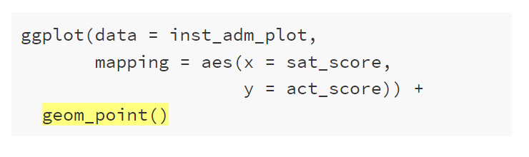
Plotting in R – Geometric Objects
Notes:
We add on geom_point()

Slide 70
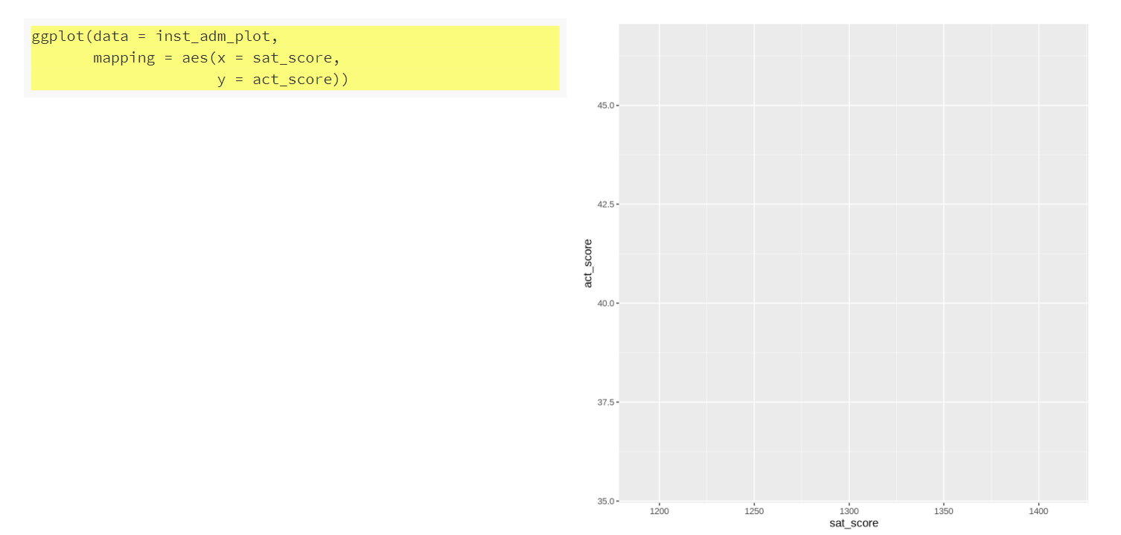
Plotting in R – Make a Scatterplot
Notes:
The ggplot() function alone sets up the axes and plot area but we have no geoms

Slide 71
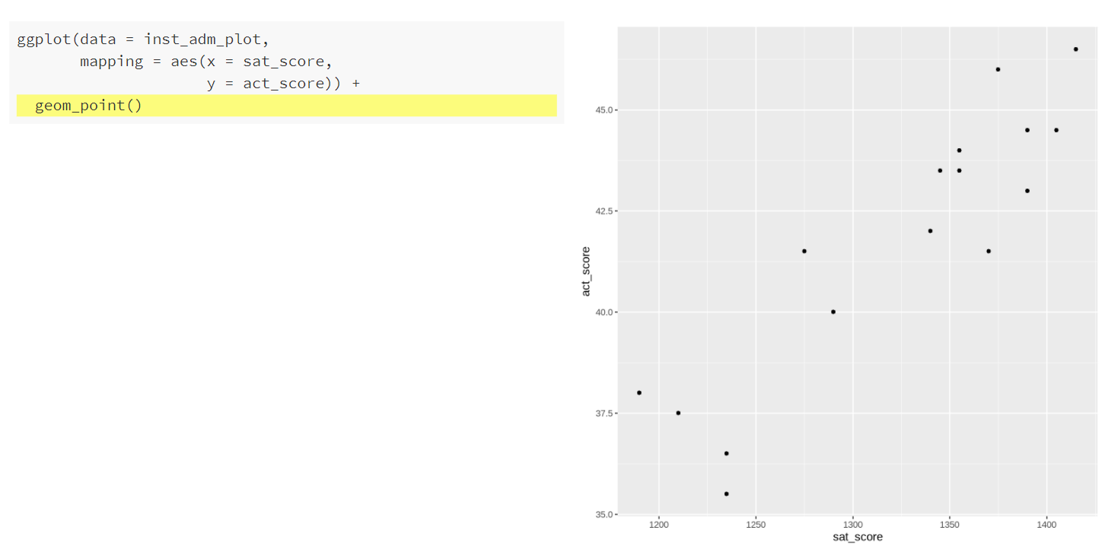
Plotting in R – Make a Scatterplot
Notes:
Now that geom_point() has been added, the points show and we have a scatterplot. Any scatterplot can be made in similar fashion by setting the x and y mappings to numeric variables

Slide 72
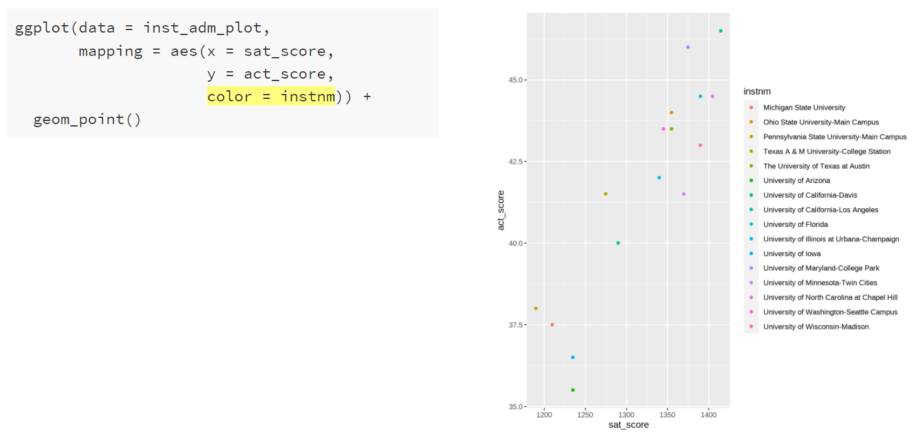
Plotting in R – Make a Scatterplot
Notes:
Color can be added to the scatterplot points by populating the “color” argument of the aesthetics mappings. Now, each point is given a color based on the institution name.

Slide 73
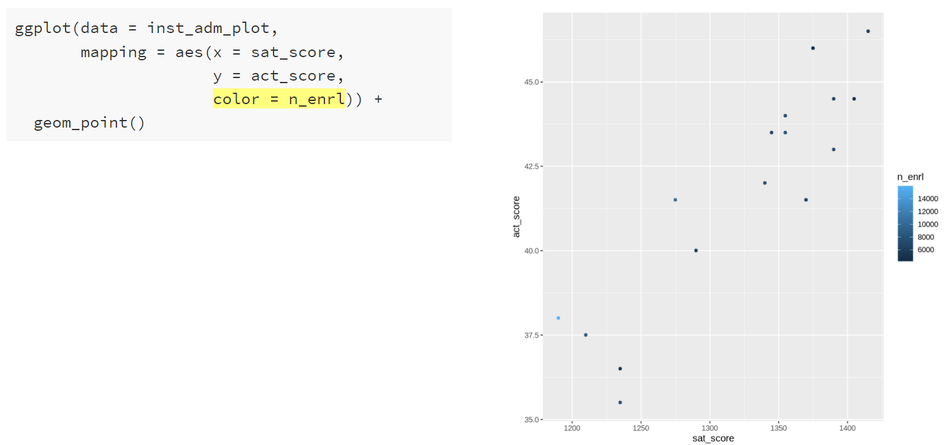
Plotting in R – Make a Scatterplot
Notes:
We can also assign color using a numeric variable, in this case R uses a gradient color scale to assign color by the number of students enrolled.

Slide 74
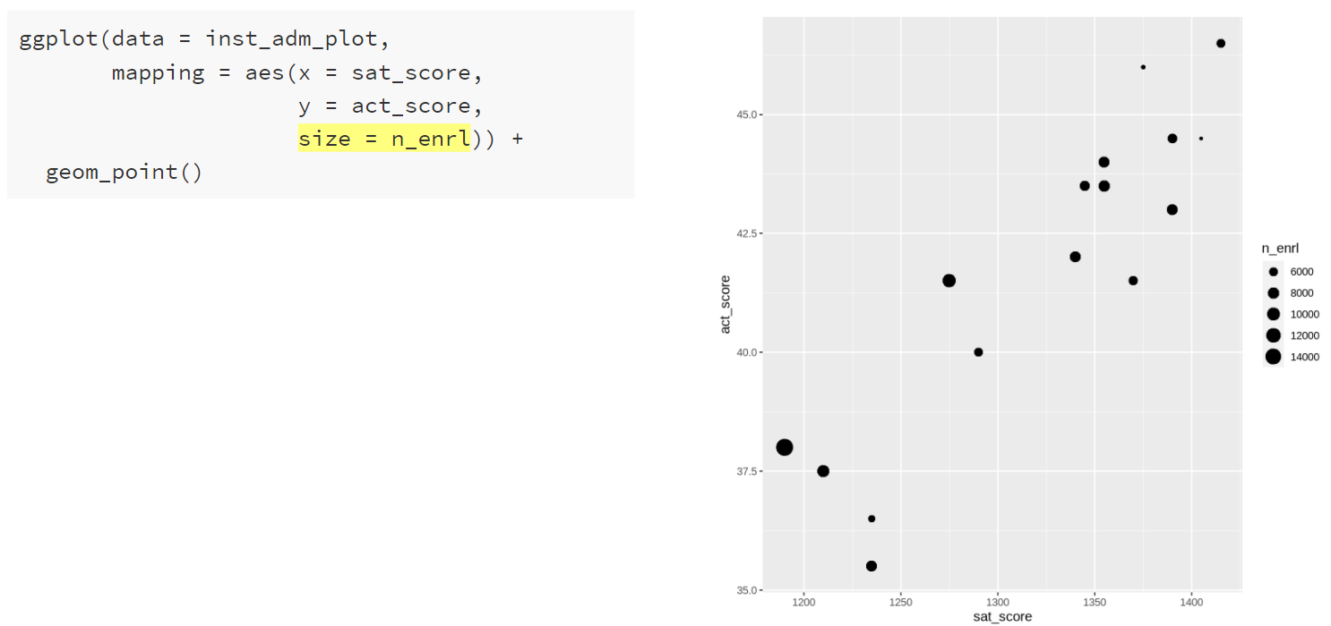
Plotting in R – Make a Scatterplot
Notes:
Another piece of the aesthetics mapping function is the size argument. We can assign this to the number of students enrolled, and it sizes the points by the number of students enrolled.

Slide 75
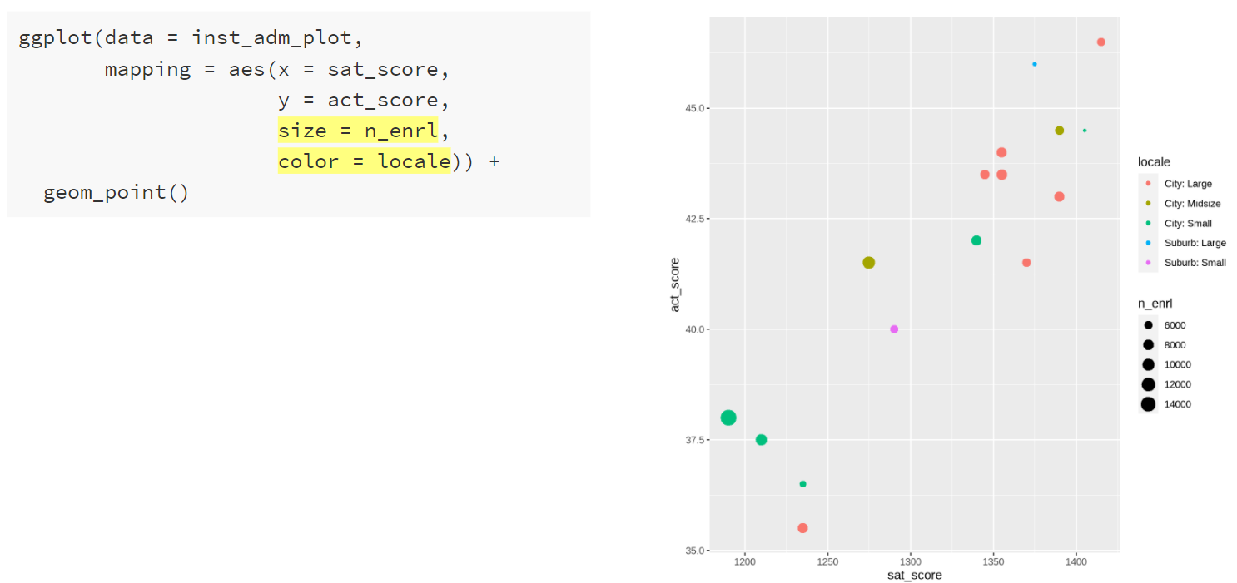
Plotting in R – Make a Scatterplot
Notes:
Size and color can be used together.

Slide 76
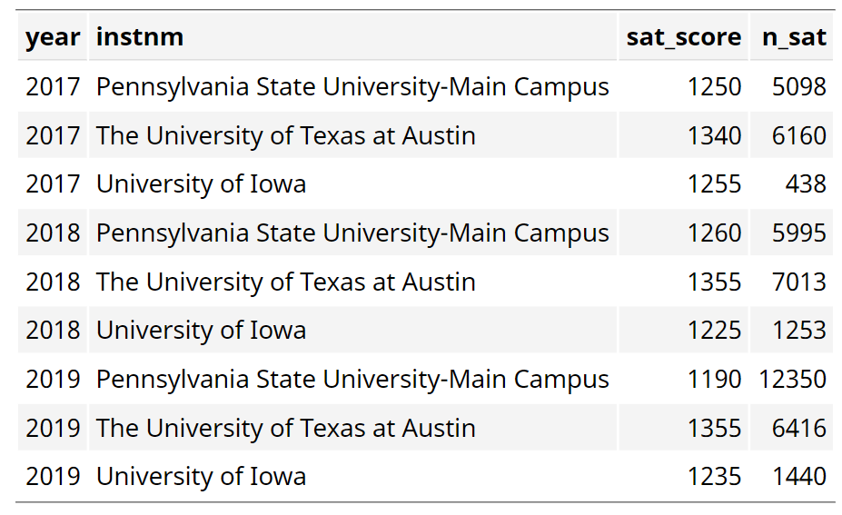
Plotting in R –Tidy Data (inst_adm_plot)
Notes:
New data set in tidy format, by year and institution, what were the SAT scores and how many applicants submitted SAT scores.

Slide 77
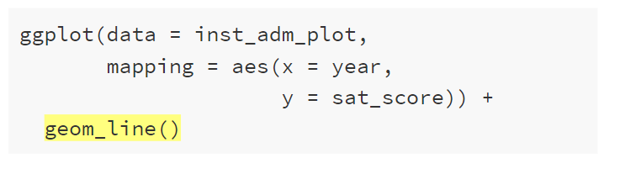
Plotting in R – Geometric Objects
Notes:
The mapping has changed slightly, now x is year and y is sat_score. Also, we’ve replaced geom_point() with geom_line().

Slide 78
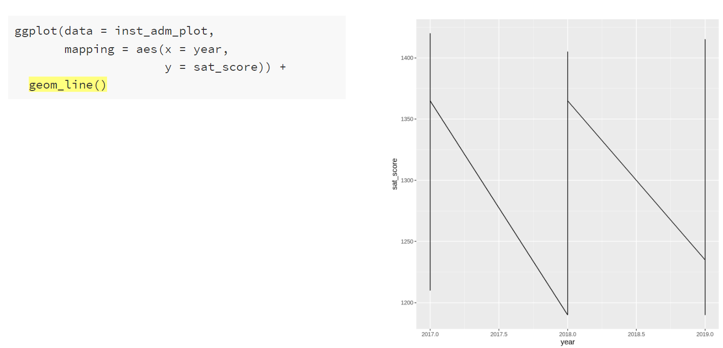
Plotting in R – Geometric Objects
Notes:
Something is not right. There’s only one line and it looks kind of odd.

Slide 79
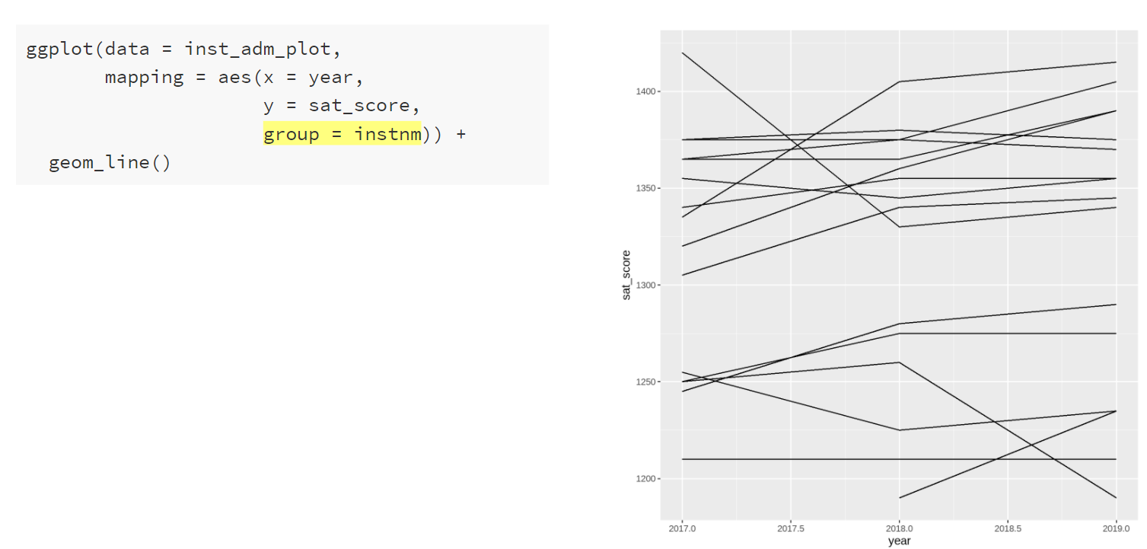
Plotting in R – Aesthetic Mappings
Notes:
We need to add the institution name (or some other unique row identifier) to the mapping so that geom_line() will create one line per row. We do this using the group argument in the aes() function. This tells the geom_line() function how to group the data together when plotting the lines.

Slide 80
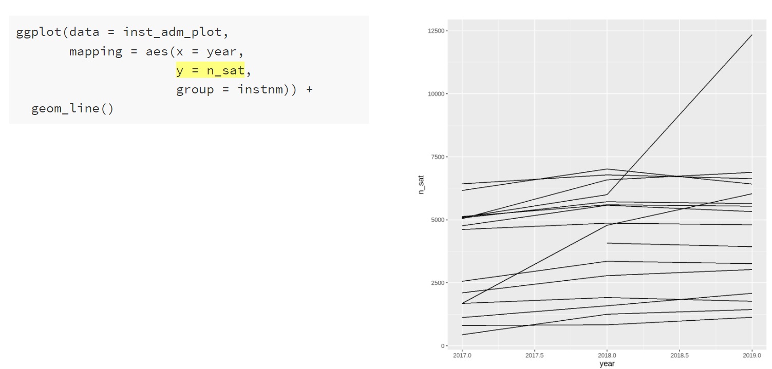
Plotting in R – Line Graph
Notes:
This is another line graph, this time with the number of students submitting an SAT score on the y-axis. There’s an outlier in 2019, I wonder which institution that is.

Slide 81
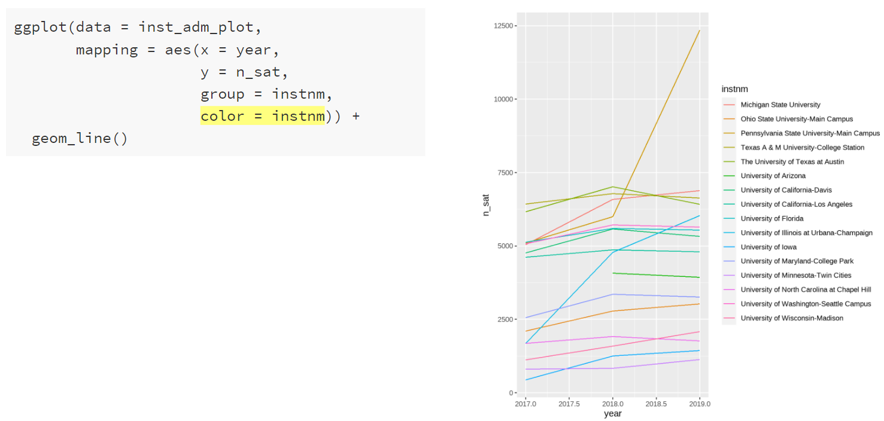
Plotting in R – Line Graph
Notes:
One way we could identify institutions in this plot is using the color argument. Similarly to the scatterplot, we can set the color argument to the institution name, and ggplot will map the name onto the color. Each line is given a different colur and we can see the list of institutions in the legend.

Slide 82
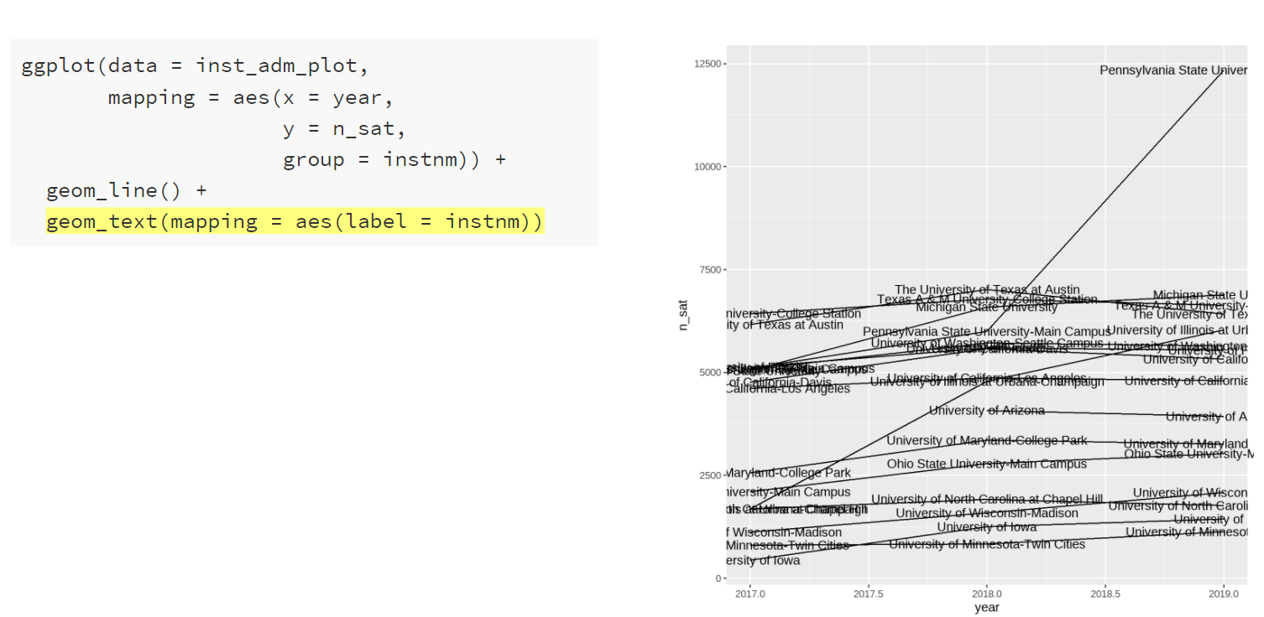
Plotting in R – Line Graph
Notes:
Another way to identify each line is using labels. We can add labels using geom_text() and adding the label argument to the aes() function. But now we get labels for every year, which is not really what we want.

Slide 83
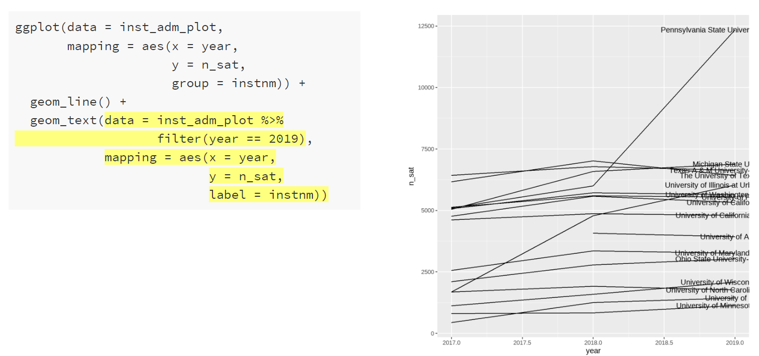
Plotting in R – Line Graph
Notes:
Let’s change the data within the geom_text() function – you can actually do this on any geom function. We will also add to the mapping argument – now we need to set the x and y aesthetic mappings for the text. Before, these mappings were pulled from the ggplot() function arguments. But the labels are quite hard to read.

Slide 84
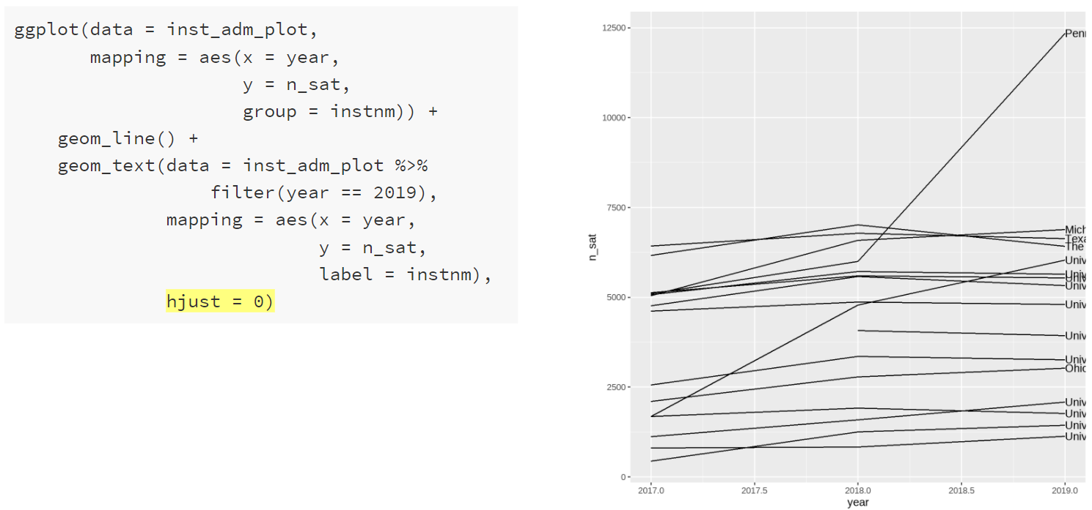
Plotting in R – Line Graph
Notes:
To move the labels to the end of the line, we use hjust = 0 to left-justify them. Within the geom_text() function, we can set the horizontal and vertical justification of the text labels.

Slide 85
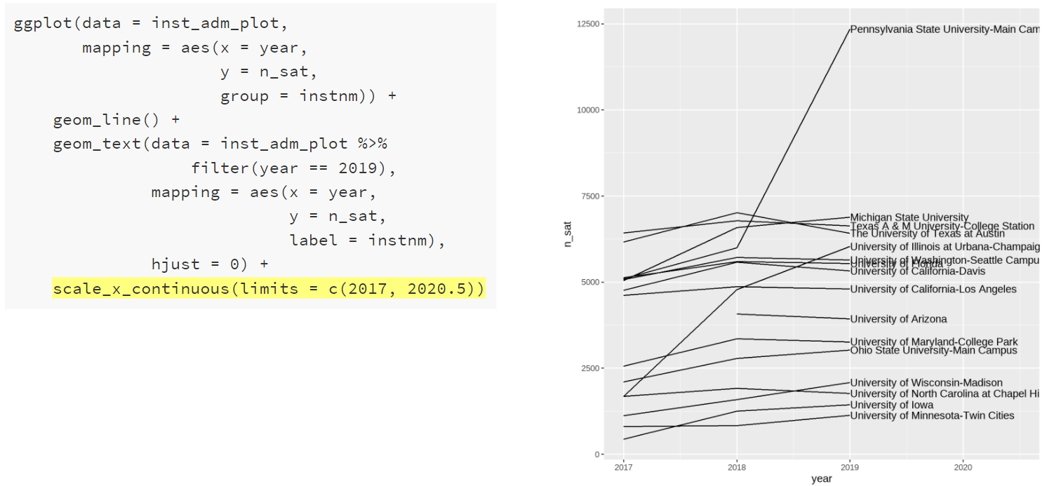
Plotting in R – Line Graph (Adjust Scales)
Notes:
We can make the labels easier to read by expanding the x-axis. Axis ranges or limits can be changed using functions like scale_x_continuous(). We use this function because the x-axis represents a continuous variable. There are similar scale functions for the y-axis, color, and size. There are also scale functions for discrete or binned variables. Here we will manually set to x-axis limits to expand the range of the axis. Now the labels are more visible. They are still not completely visible, and we could adjust the upper limit further to view the whole label. Or we could take a different approach to add these labels.

Slide 86
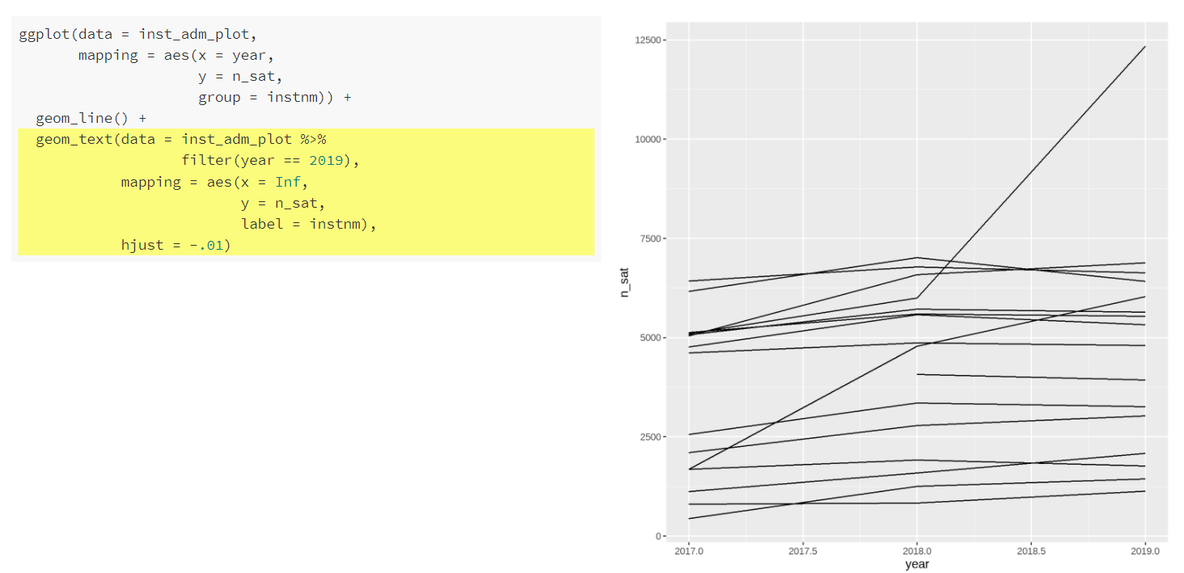
Plotting in R – Line Graph
Notes:
To make the labels easier to read, we can make one change to the mapping in the geom_text() function. We set the x argument equal to infinity to push the labels off the plot. We also use the horizontal justification argument hjust to left justify the labels and then move them slightly in. hjust = 0 is right justified, hjust = 0.5 is centered, and hjust = 1 is left justified. You will notice that we can’t actually see any of the labels right now.

Slide 87
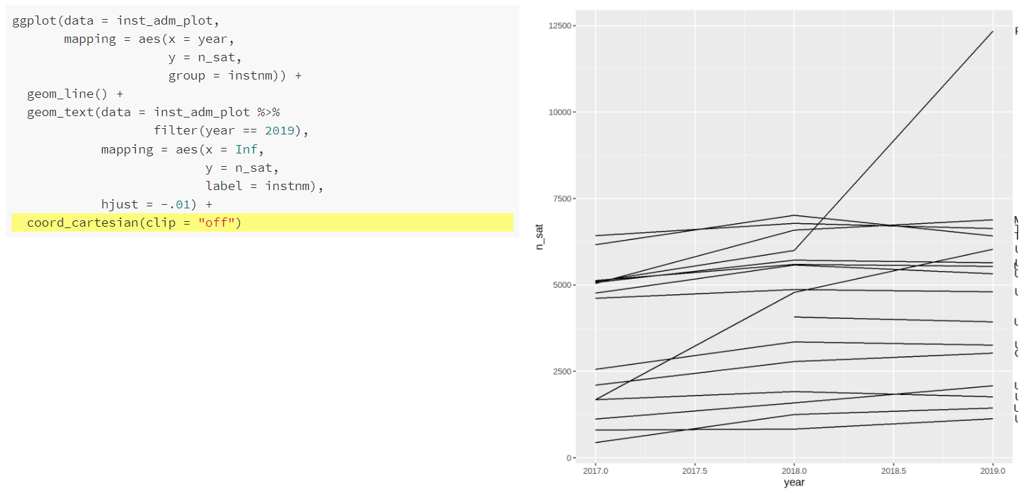
Plotting in R – Line Graph
Notes:
We’ve added a new function coord_cartesian(). This function is used to zoom in or out the plot without changing the underlying data or axis limits. If we set clip to “off” (the default is on), then the drawing of ggplot elements can extend past the plot panel. The plot panel is the area in which the geometric elements are drawn in a plot (the grey area). We still cannot really see our labels, but by setting the clip to “off” it allows the text elements to be drawn outside of the plot panel, which is what we want.

Slide 88
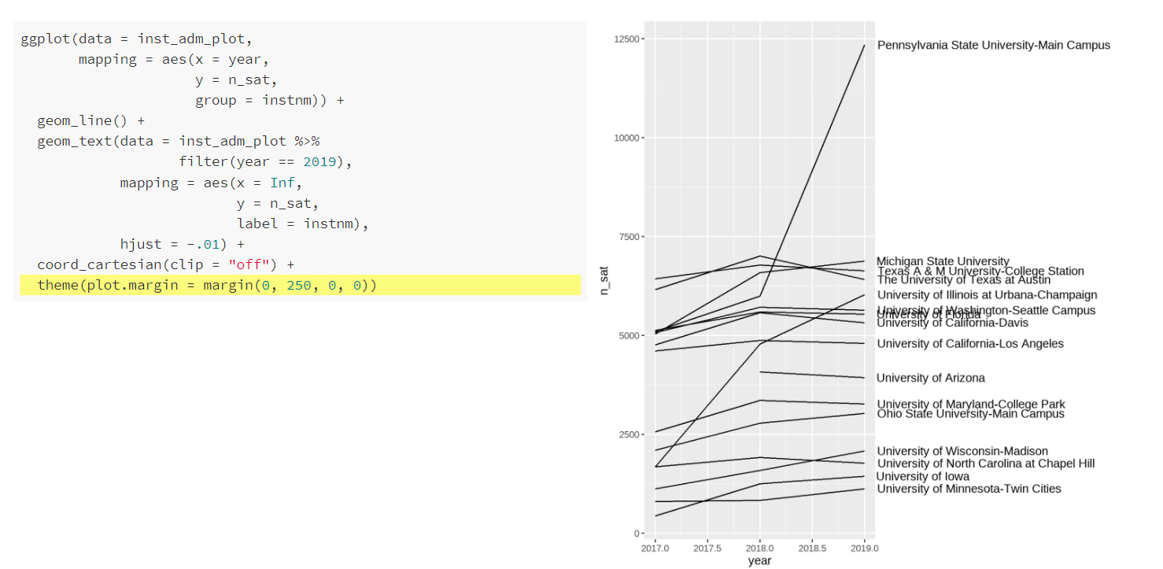
Plotting in R – Line Graph
Notes:
Finally, we use another new function theme(). The theme() function allows us to manually set all of the plot formatting. We can use it to change fonts, manipulate spacing, and change colors. Generally, it controls the way the plot looks. In this instance, we are going to use the plot.margin argument to extend the right-hand margin so that we can view the entire label. We will get more into the theme function tomorrow. It is very useful for customizing the look of your plots.

Slide 89
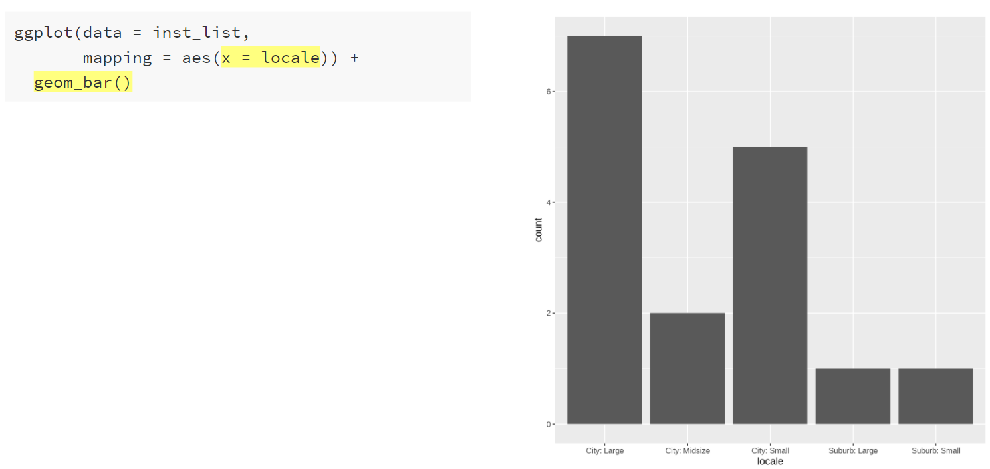
Plotting in R – Geometric Objects
Notes:
For a bar graph, geom_bar() will compute summary information for us, so we just need to provide the x-axis category and geom_bar() will compute the count. We can provide other functions instead of the count, and we can make bar graphs using a provided y variable, as we’ll see shortly.

Slide 90
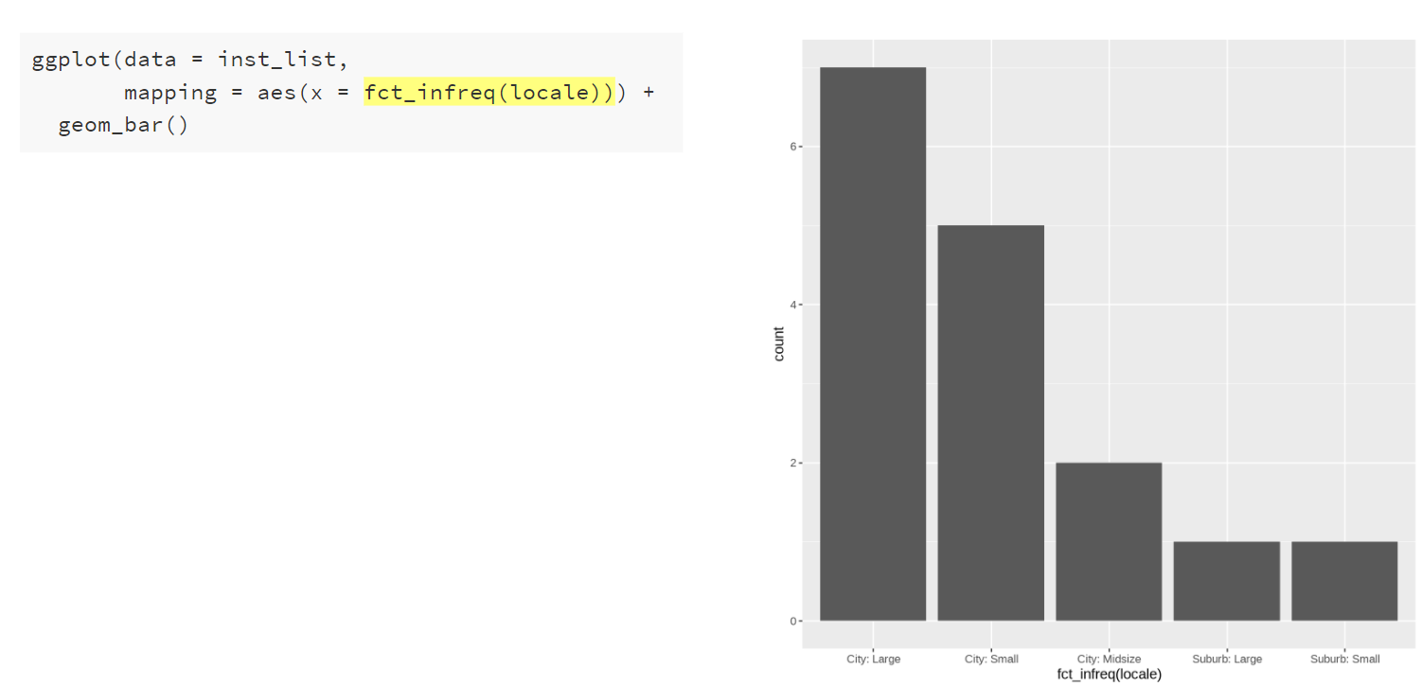
Plotting in R – Aesthetic Mapping
Notes:
We can reorder the bars from greatest to least frequency/count using a handy function fct_infreq(). This function is from the forcats package in tidyverse; fct_infreq() reorders the levels by their frequencies. There are a few ways that reordering the data on an axis or legend can be accomplished; this is just one way. But it usually occurs within the mapping argument.

Slide 91
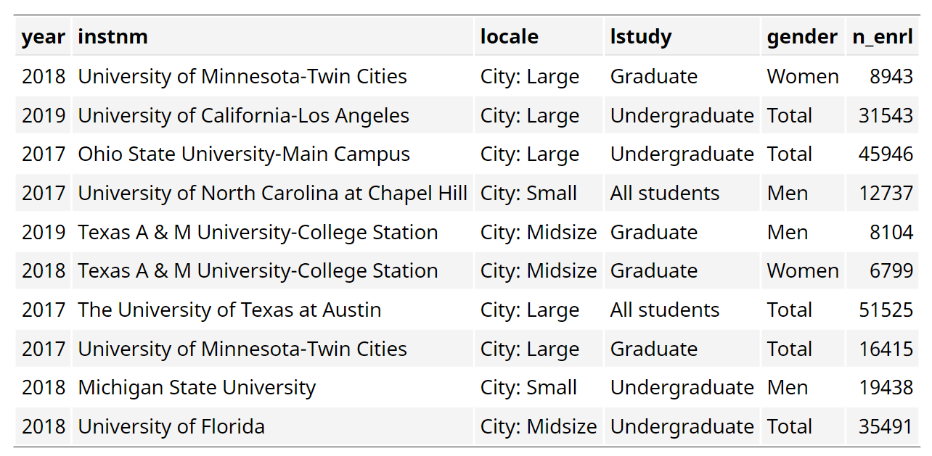
Plotting in R – Tidy Data (inst_enrlmnt_plot)
Notes:
What if we want to plot something other than counts in a bar graph?
This dataset is the enrollment by year for each institution, at the level of study, and by gender. We will be filtering to “All Students” and “Total” to make a plot of enrollment by locale/urban area.

Slide 92
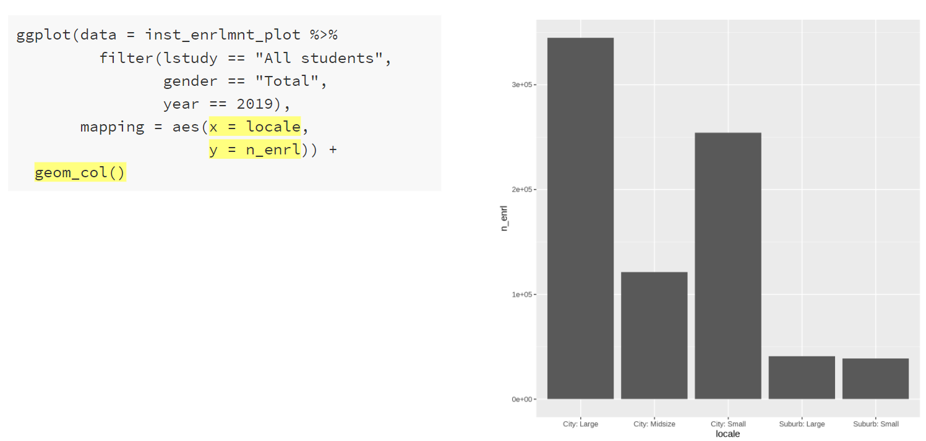
Plotting in R – Geometric Objects
Notes:
Here’s a different geom function – geom_col() this function plots the total of the numeric variable provided in the x or y mapping. In this case, we’ve got y = n_enrl so it’s plotting the total enrollment for each locale/urban area. Let’s see this in more detail.

Slide 93
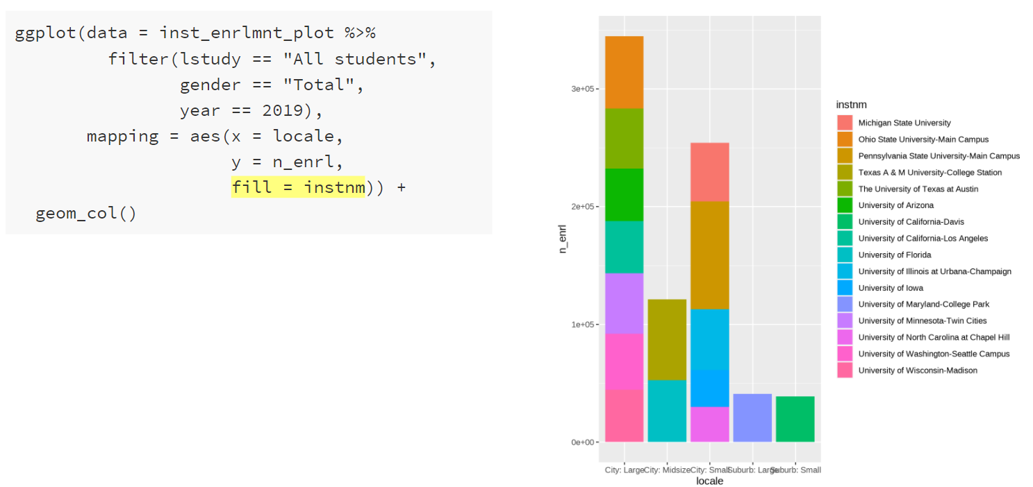
Plotting in R – Aesthetic Mapping
Notes:
By adding a fill argument to the aes() function in the mapping argument, we’ve added color to the bars. One color for each institution. Now we can see how the geom_col() function is putting each institution’s enrollment on top of each other to create this chart. Later on we’ll see how we could make side by side bars instead of stacked bars.

Slide 94
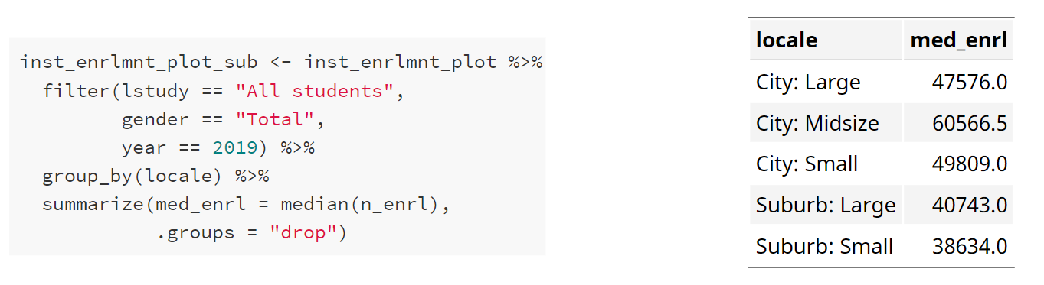
Plotting in R – Tidy Aggregated Data
Notes:
What if we want to plot the median enrollment by area instead of the total?
We can make an aggregated dataset and then plot it.

Slide 95
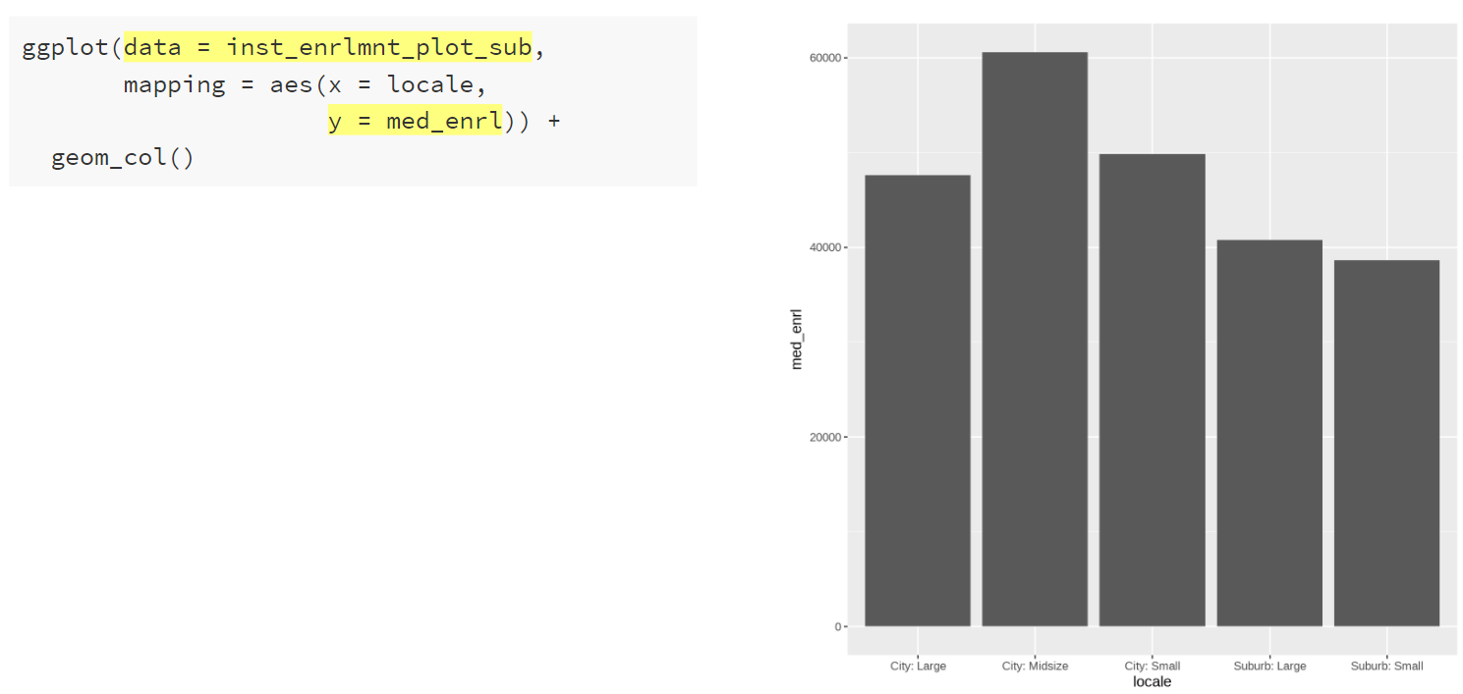
Plotting in R – Bar Graph of Aggregated Data
Notes:
With the aggregated data set, we can set the mapping to plot med_enrl on the y-axis.

Slide 96

Plotting in R – Bar Graph of Aggregated Data
Notes:
Then we can reorder the x-axis values by the med_enrl. This is another method of sorting data within ggplot. In this case, we’re using the reorder() function. The first argument is the variable to reorder and the second argument is the variable to reorder the first variable by. We use a minus sign in front of med_enrl to sort in descending order.

Slide 97
BREAK

Slide 98
Plotting in R – Tidy Data (inst_enrlmnt_plot)
Notes:
Going back to this data, what if we wanted to plot the enrollment by institution and locale/urban area? How could we make a plot with all of the institutions subset by urban area?
Faceting is how small multiples can be made in R/ggplot.

Slide 99

Plotting in R – Facets
Notes:
We start with the ggplot() function. Setting our data to our enrollment data set and filtering to All Students and Total gender and 2019. Then we add the mapping of enrollment to the x-axis and institution name, ordered by enrollment to the y-axis.

Slide 100

Plotting in R – Facets
Notes:
We add on geom_col() to make the bars.

Slide 101

Plotting in R – Facets
Notes:
Then we use the facet_wrap() function to make small multiples for each locale/urban region. Essentially, we’re saying, make a new plot like this for every locale. But, we don’t really need every institution on each plot, because each institution is only in one locale. And maybe it would look better if all the small plots were in one column.

Slide 102

Plotting in R – Facets
Notes:
We do this by setting the scales argument to “free_y” within the facet_wrap() function, which means that each plot gets it’s own y-axis. We also set ncol to 1 within facet_wrap(), which puts all the plots in one column.

Slide 103

Plotting in R – Tidy Aggregate Data (inst_enrlmnt_plot_sub)
Notes:
Before we looked at median enrollment by locale/urban area in a single year - 2019. Now we’re going to look at median enrollment by locale/urban area over time.

Slide 104

Plotting in R – Aesthetic Mapping & Geometric Objects
Notes:
Using fill in the aesthetics function, we can add color to the bars (as we saw earlier). Now we will also add position = “dodge” to the geom_col() function to put the bars next to each other in each year. When we add a variable to the fill mapping, you’ll notice that ggplot automatically gives us a legend.

Slide 105

Plotting in R – Facets & Formatting
Notes:
We can use facet_wrap to make small multiples by locale/urban area and remove the legend using guides(fill = FALSE). Note that we don’t really need position = “dodge” here anymore since each faceted plot will only have three columns, one for each year.

Slide 106

Plotting in R –Geometric Objects
Notes:
Trends over time look best with lines rather than bars, so we can replace the geom_col() with geom_line. But what happened to the color? We still have fill set.

Slide 107

Plotting in R – Aesthetic Mapping
Notes:
For lines and points, we use the aesthetic mapping color while for bars, histograms, and boxplots, we use the aesthetic mapping fill.

Slide 108

Plotting in R – Tidy Data (inst_compl_plot)
Notes:
So far, we’ve gone over a few different plot types, how to add color, and faceting. But how do you edit the colors and theme of the plot to get something that looks really nice? We’ve seen some pretty strange and unhelpful axis labels? How do we fix that?
We’ll now discuss how to add labels and formatting. We’re going to use data on degree completions. This data provides the number of degrees awarded by year, institution, degree level, and gender.

Slide 109

Plotting in R – Initial Plot
Notes:
This is the initial plot. For the University of Arizona (filtered by unitid), this plot show the number of degrees awarded over the past three years by award level.
A few things to notice, the degree levels are not in a sensible order, the years have decimal points, the axis labels are not ideal (especially the y-axis), there’s no title, and it might be nice to have something other than the grey plot background and perhaps alternate colors for the degree levels.

Slide 110

Plotting in R – Reorder Degree Levels
Notes:
First we will reorder the degree levels. This is now the third way we’ve used to reorder values. In this instance, we are manually setting the factor levels for the award level variable to be the order we want. Notice the change to the legend title as well.

Slide 111

Plotting in R – Add Titles
Notes:
Second, we’ll add a plot title and change the x-axis title. Then we’ll remove the y-axis and legend titles.

Slide 112

Plotting in R – Move Legend
Notes:
Next, we will move the legend to the top of the plot

Slide 113

Plotting in R – Add Caption
Notes:
Adding a caption argument in the labs() function allows us to note where the data came from.

Slide 114

Plotting in R – Add Theme
Notes:
Then we’ll add a theme to change the background and appearance of the plot. There are several built in themes in ggplot2; there are also additional packages that have more themes like ggthemes and hrbrthemes. Here we’re using theme_minimal() from ggplot2. The background is now gone; the axis ticks now match the gridlines; the legends has a white background; and the gridline color is now grey.

Slide 115

Plotting in R – Adjust Scales
Notes:
We can easily add commas to the y-axis labels using the scale_y_continuous() function and the comma function from the scales package on the labels argument.

Slide 116

Plotting in R – Adjust Scales
Notes:
We can also remove the decimals from the x-axis and remove the half-year (2017.5, etc.) labels using scale_x_continuous() and the breaks argument, which allows us to manually set the x-axis breaks or x-axis ticks.

Slide 117

Plotting in R – Adjust Scales
Notes:
We can manually set the labels for the x-axis in scale_x_continuous(). Here we set it to a vector of labels we created.

Slide 118

Plotting in R – Geometric Objects
Notes:
It might be nice to have points for each year with lines connecting them. We can layer geoms to make this happen. Note the show.legend = FALSE in the geom_line() function. Without this, the legend would show a line and a point.

Slide 119

Plotting in R – Adjust Scales
Notes:
Scale functions are also available for the color (and fill). Here we use scale_color_brewer() to select a color palette from ColorBrewer.

Slide 120

Plotting in R – Adjust Scales
Notes:
Scale functions are also available for the color (and fill). Here we use scale_color_manual() to set our own colors using hex codes for University of Arizona brand colors. Note how the values in the scales_color_manual() correspond to the levels of the variable mapped to color.

Slide 121

Plotting in R – Saving
Notes:
To save, assign the plot to an object (line_plot) and then use the ggsave() function. Here you can set the output type (png, svg, jpg, pdf) and you can set the width and height to get the formatting and output to look right.

Slide 122

Plotting in R – Saving
Notes:
To save, assign the plot to an object (line_plot) and then use the ggsave() function. Here you can set the output type (png, svg, jpg, pdf) and you can set the width and height to get the formatting and output to look right.

Slide 123
Artwork by @allison_horst
Notes:
ggplot2 can also be used to create well designed and engage data visualizations and infographics. It’s flexibility allows for almost endless customization.

Slide 124
Artwork by @allison_horst
Notes:
ggplot2 can be used to complete visual data exploration. Once you get the hang of it, it’s very easy to quickly generate rough plots to explore your data.

Slide 125
Where to go next
Experiment with the provided code and data sources. There are many other plots that could be made using this data.
Some Resources:
ggplot2: Elegant Graphics for Data Analysis by Hadley Wickham
Data Visualization Chapter in R for Data Science by Hadley Wickham & Garrett Grolemund
ggplot2 Reference Guide
Notes:
The provided code includes tidy data for completions, enrollments, and admissions for the 16 schools selected. It could also be adapted to include different institutions but be aware that I manually set some of the descriptive values, and they may not match a different list of institutions. That being said, the dictionaries are included in the zip file of documents for this webinar, so you could adapt the code as needed using the dictionaries. Play around with the provided code and see what happens if you change the arguments. Try to create similar plots with different datasets, for example, make a bar plot of the degrees awarded. How could you make a lollipop chart or a dot plot of degrees awarded rather than a bar plot? Ggplot2 can be used to make many, many different kinds of plots from histograms and box plots to maps and Sankey diagrams.

Slide 126
What did we learn today?
How to make a bar graph in R
How to make add titles and labels to a graph in R
How to change the formatting of a graph in R
How to save a graph in R
Where to find more information on ggplot2

Slide 127
Questions

Slide 128
References
Battle-Baptiste, W., & Rusert, B. (2018). W.E.B. Du Bois's Data Portraits: Visualizing Black America: The color line at the turn of the Twentieth Century. Princeton Architectural Press.
Cairo, A. (2016). The truthful art: Data, charts, and maps for communication. New Riders
D’Ignazio, C., & Klein, L. F. (2020). Data feminism. The MIT Press.
Few, S. (2006). Information dashboard design. O’Reilly Media, Inc.
Healy, K. (2019). Data visualization: a practical introduction. Princeton University Press.
Heer, J., & Bostock, M. (2010). Crowdsourcing graphical perception: Using mechanical turk to assess visualization design. In Proceedings of the sigchi conference on human factors in computing systems (pp. 203–212). New York, NY, USA: ACM. https://doi.org/10.1145/1753326.1753357
Knaflic, C. N. (2015). Storytelling with data: A Data Visualization Guide for Business Professionals. John Wiley & Sons, Inc.
Munzner, T. (2011). Visualization Principles [PDF slides]. Department of Computer Science, University of British Columbia. https://www.cs.ubc.ca/~tmm/talks/vizbi11/vizbi11.pdf
Tableau. (n.d.). What is data visualization? definition, examples, and learning resources. Tableau. Retrieved January 18, 2022, from https://www.tableau.com/learn/articles/data-visualization
Tufte, E. R. (2001). The visual display of quantitative information. Graphics Press.
Tukey, J. W. (1977). Exploratory data analysis. Addison-Wesley Publishing Company.
Wexler, S. (2021). The big picture: How to Use Data Visualization to Make Better Decisions. McGraw Hill.
Wickham, H. (2010). A layered grammar of graphics. Journal of Computational and Graphical Statistics, 19(1), 3-28. Retrieved March 7, 2021, from http://vita.had.co.nz/papers/layered-grammar.pdf
Wong, D. M. (2013). The wall street journal guide to information graphics: The dos and don'ts of presenting data, facts, and figures. Norton.

